Slide 1

Old Arabi Neighborhood Association Meeting
September 13, 2018

Slide 2
AGENDA:
Pledge
Scholarship Renewal
Upcoming Sippin
Sugar Fest 10
Night Out Against Crime
An answer to a burning question
Planetarium Show Dates
Update
Door Prize
Adjournment / Sugar Fest Meeting

Slide 3

Notes:
Pledge, then year in review

Slide 4
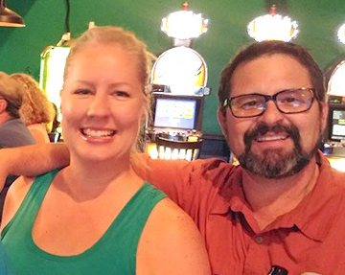
Glad You’re OK

Slide 5
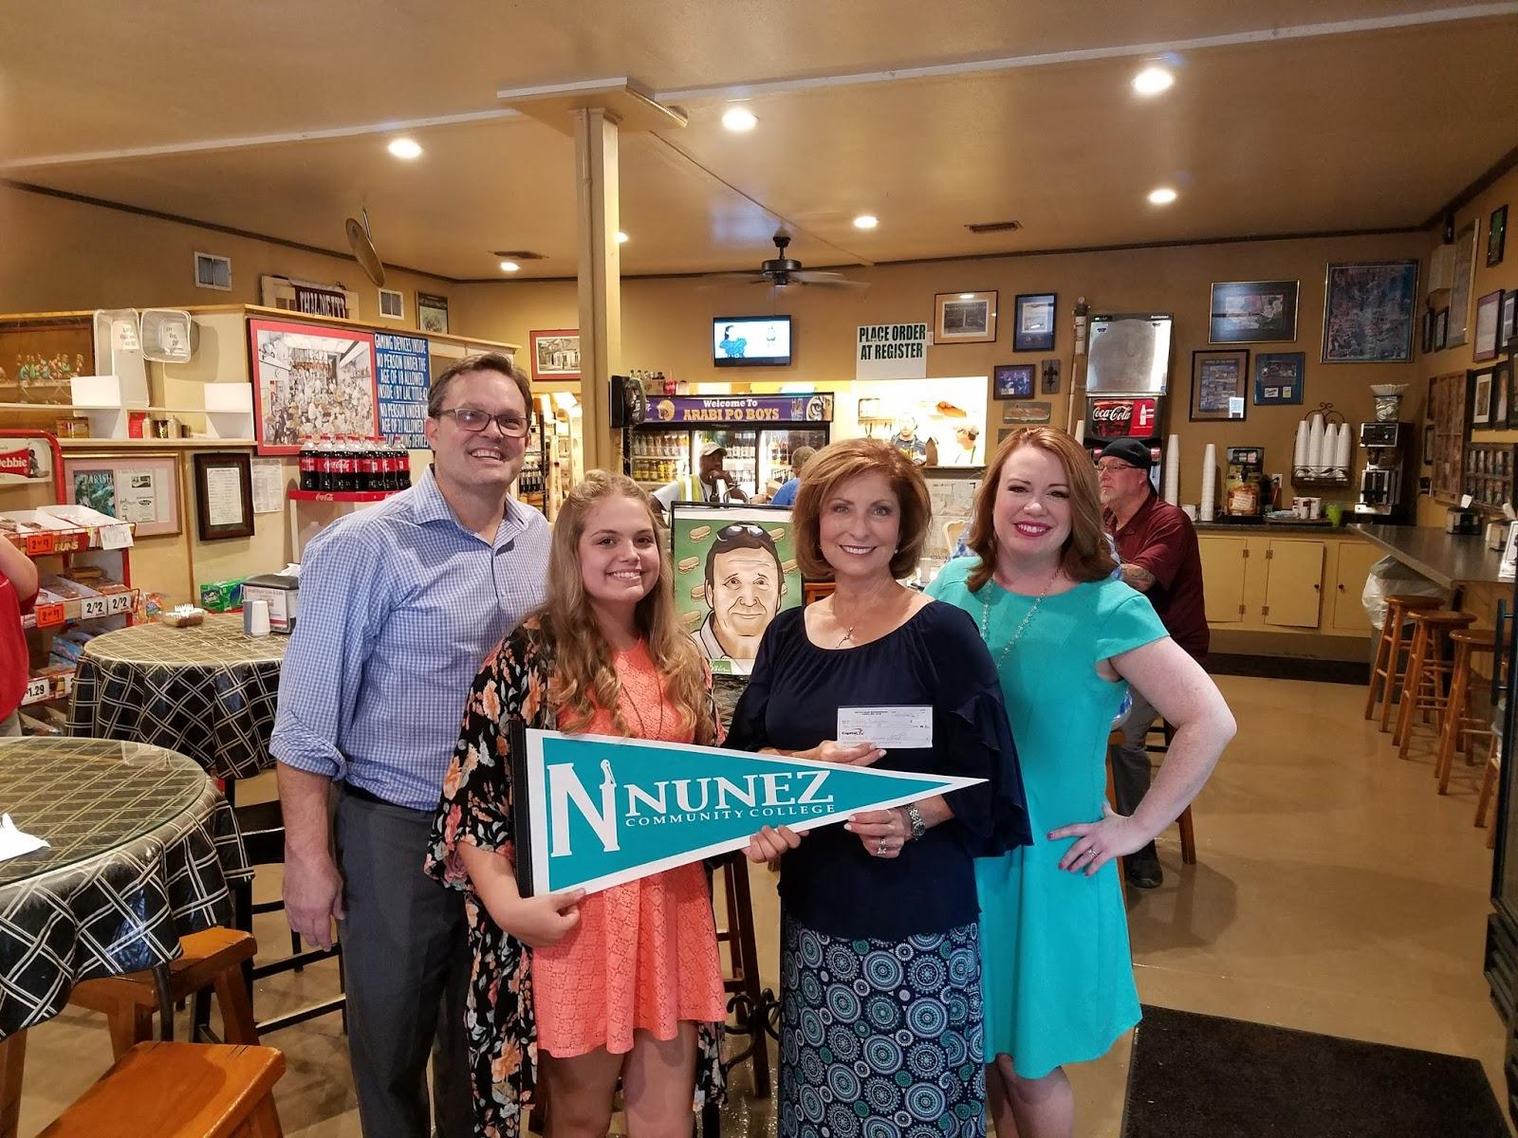
Mitchell Smith Scholarship
To continue to the Mitchell Smith Culinary Legacy, OANA recently awarded $1000 to Hailey Bauman, an Arabi resident and a culinary student at Nunez Community College.

Slide 6
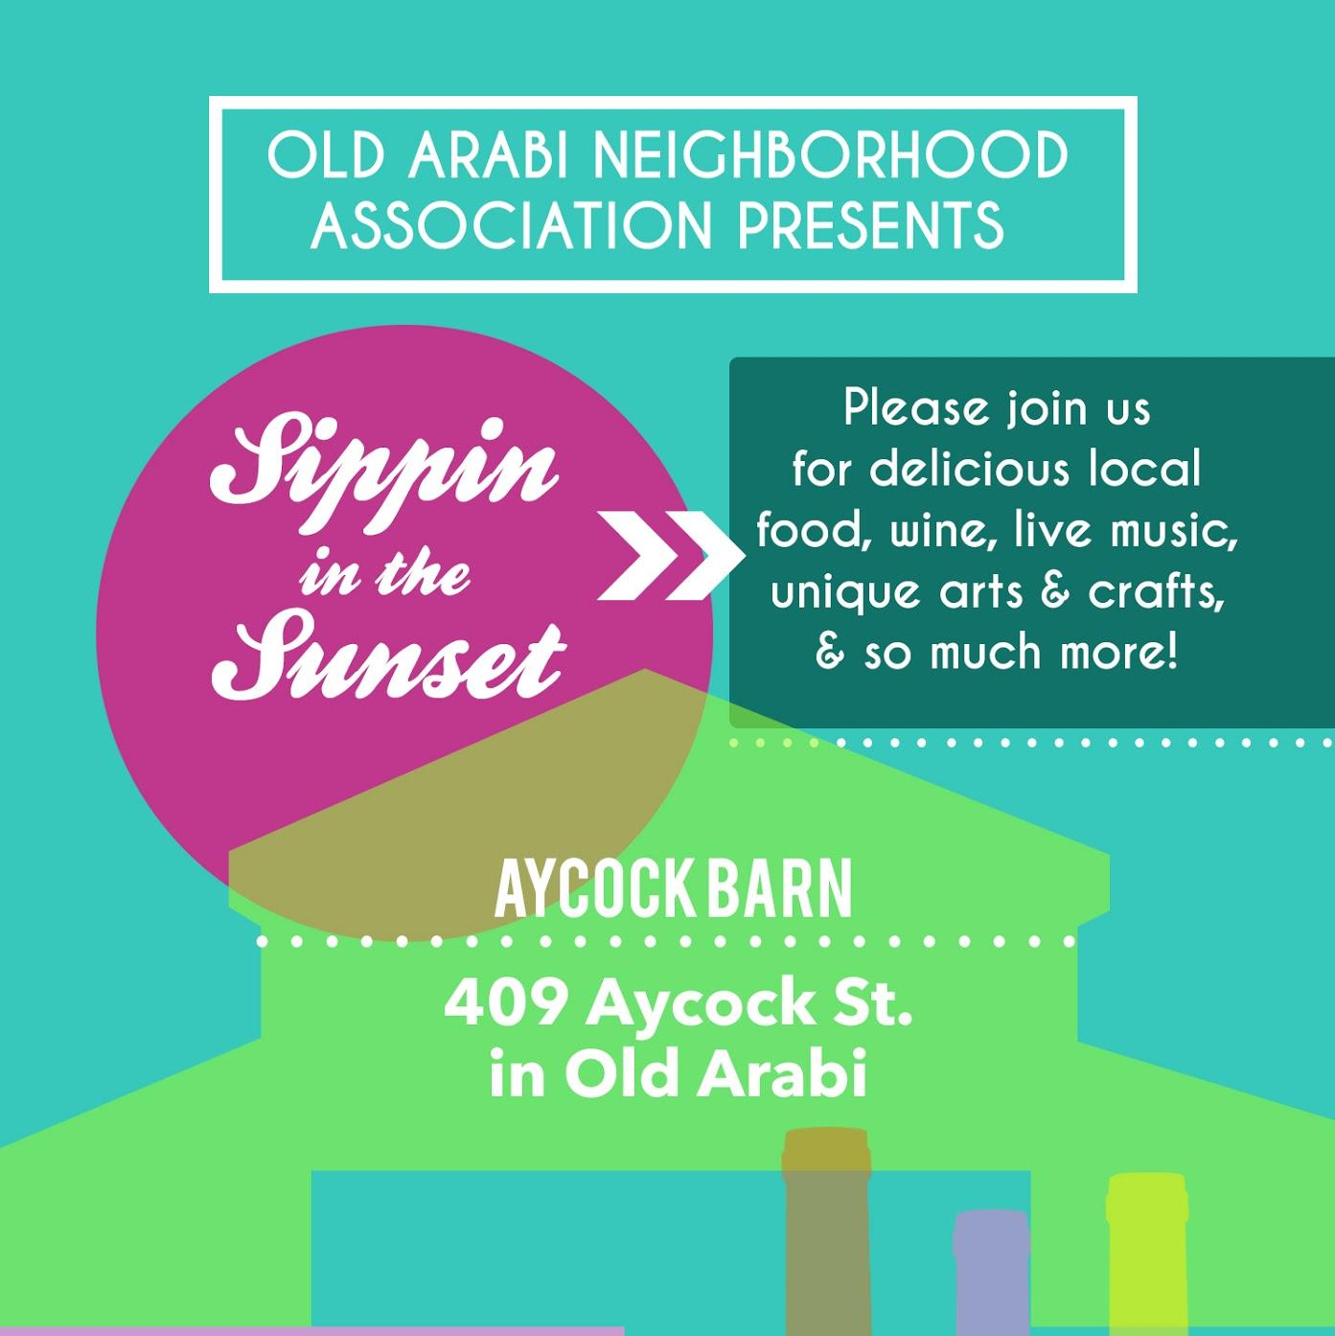
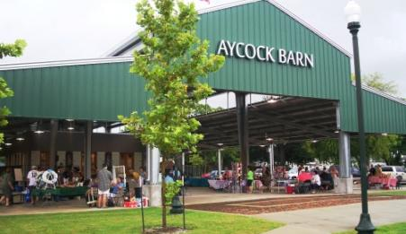
Sippin in the Sunset 2018
Back to School Sippin!
Thursday, September 20th 6 - 9 pm at the Aycock Barn

Slide 7
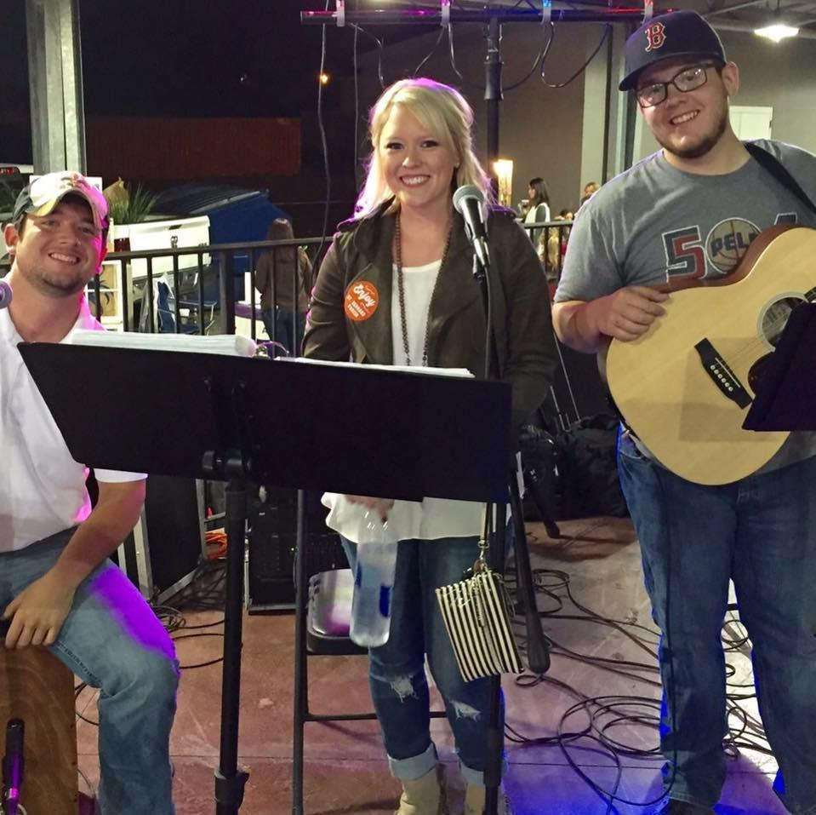
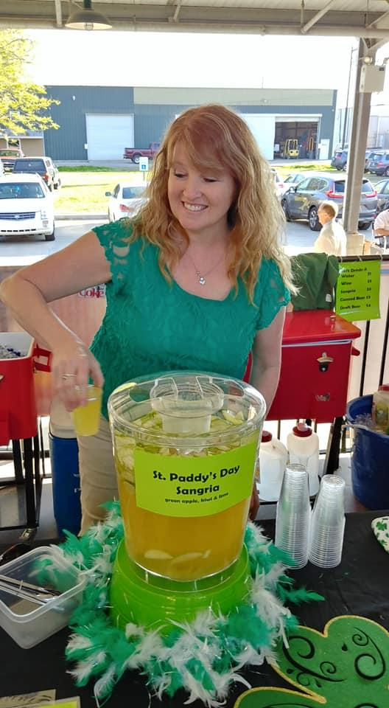
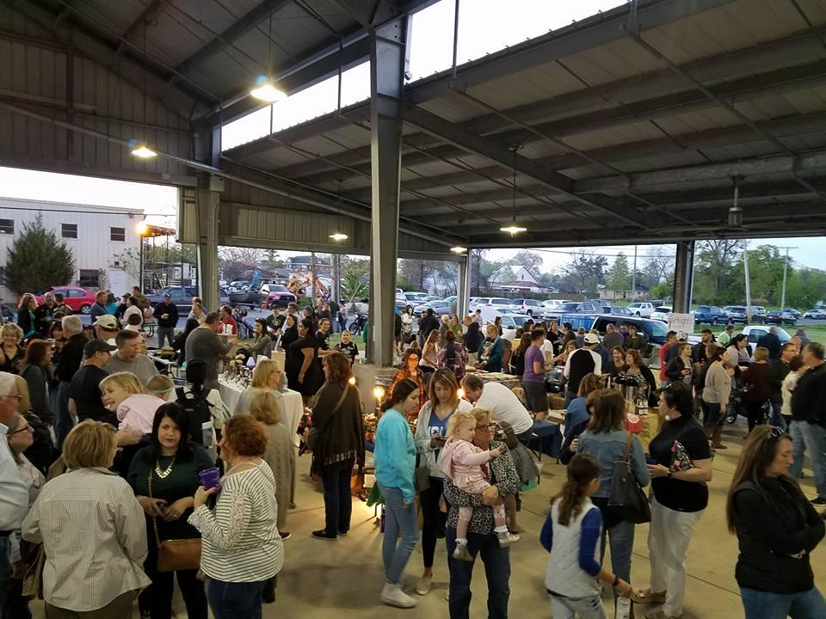
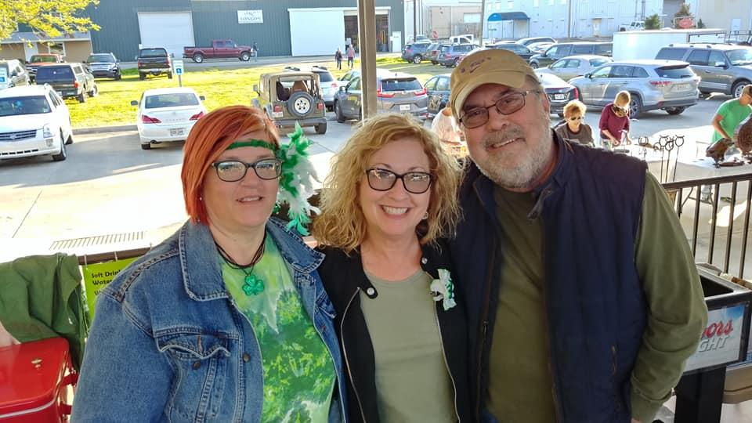
Cypress Pop Trio, Susan Sangria, and a lot of fun
Thanks to our volunteers !

Slide 8
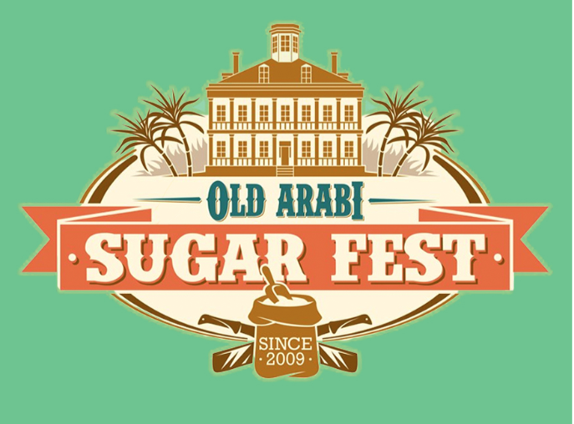
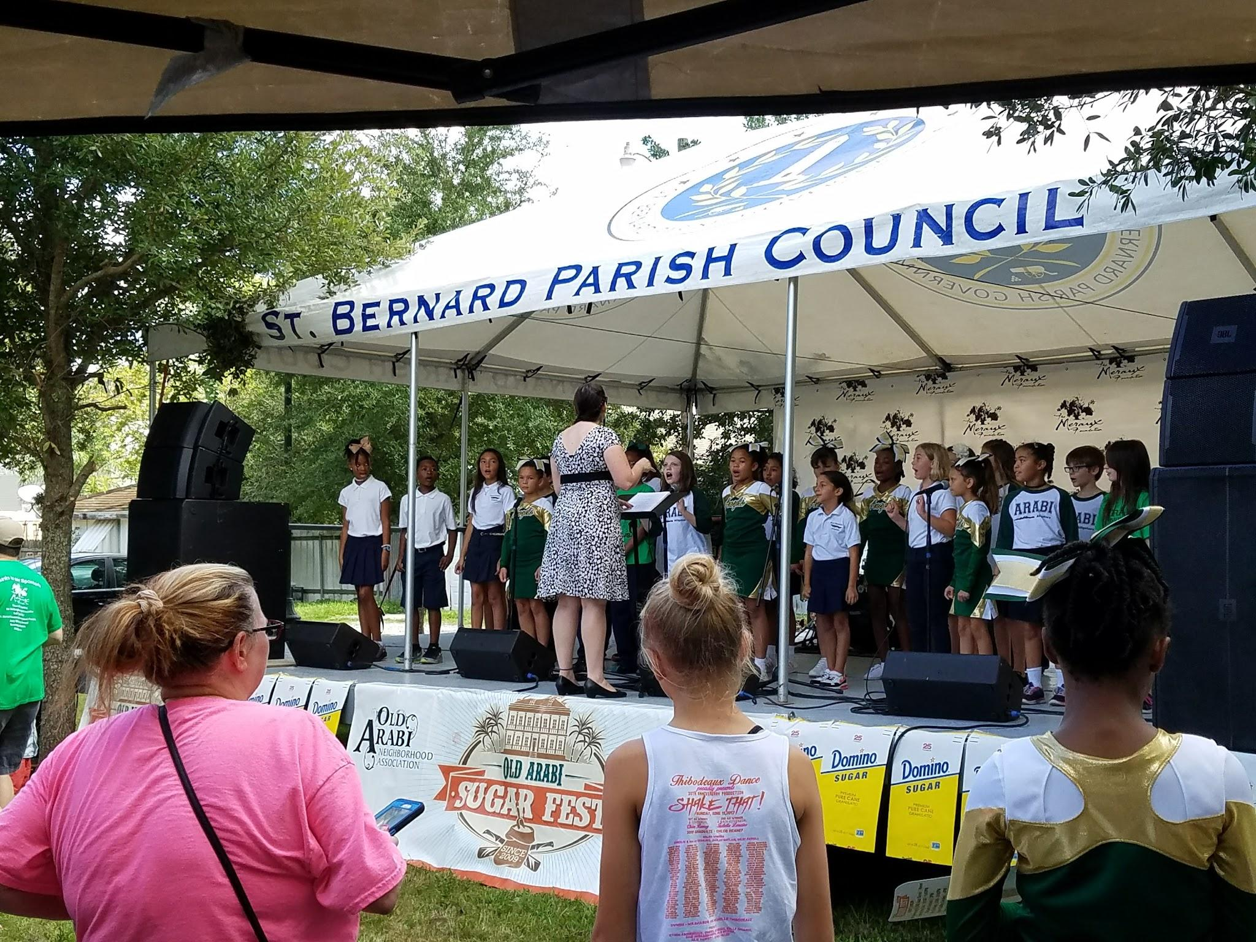
2018 will be the 10th Anniversary of the Sugar Festival. If you are interested in helping to make it even sweeter, sign up for the Sugar Fest Committee with Ray Lauga.

Slide 9
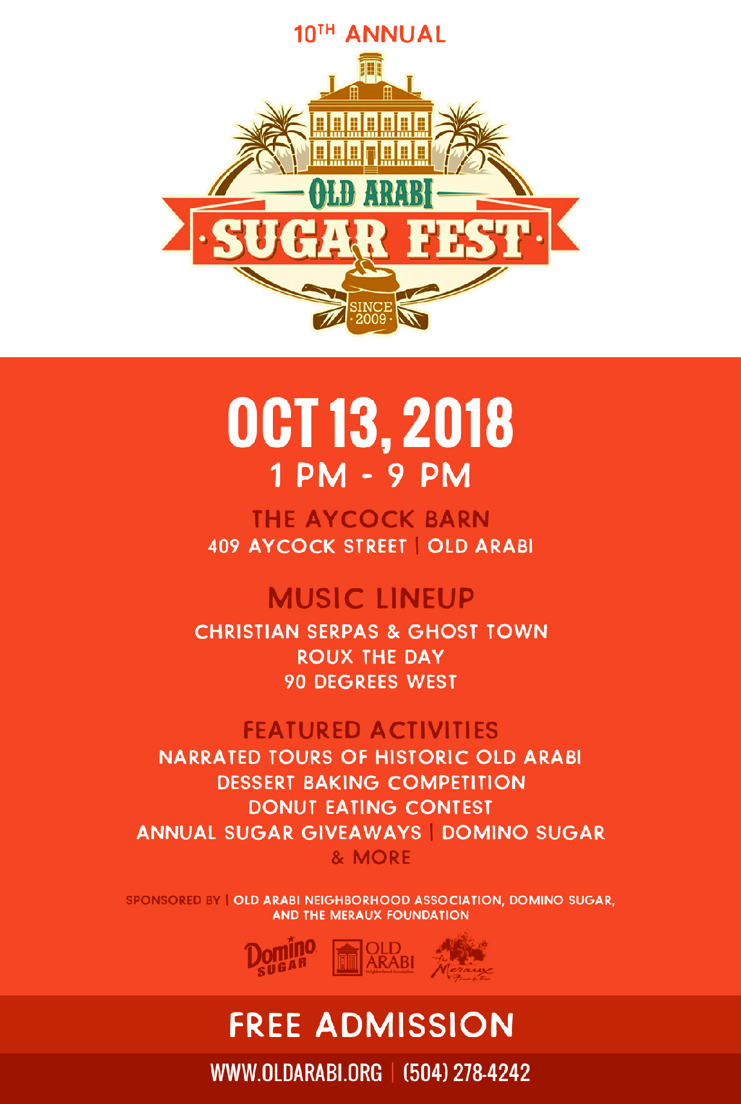
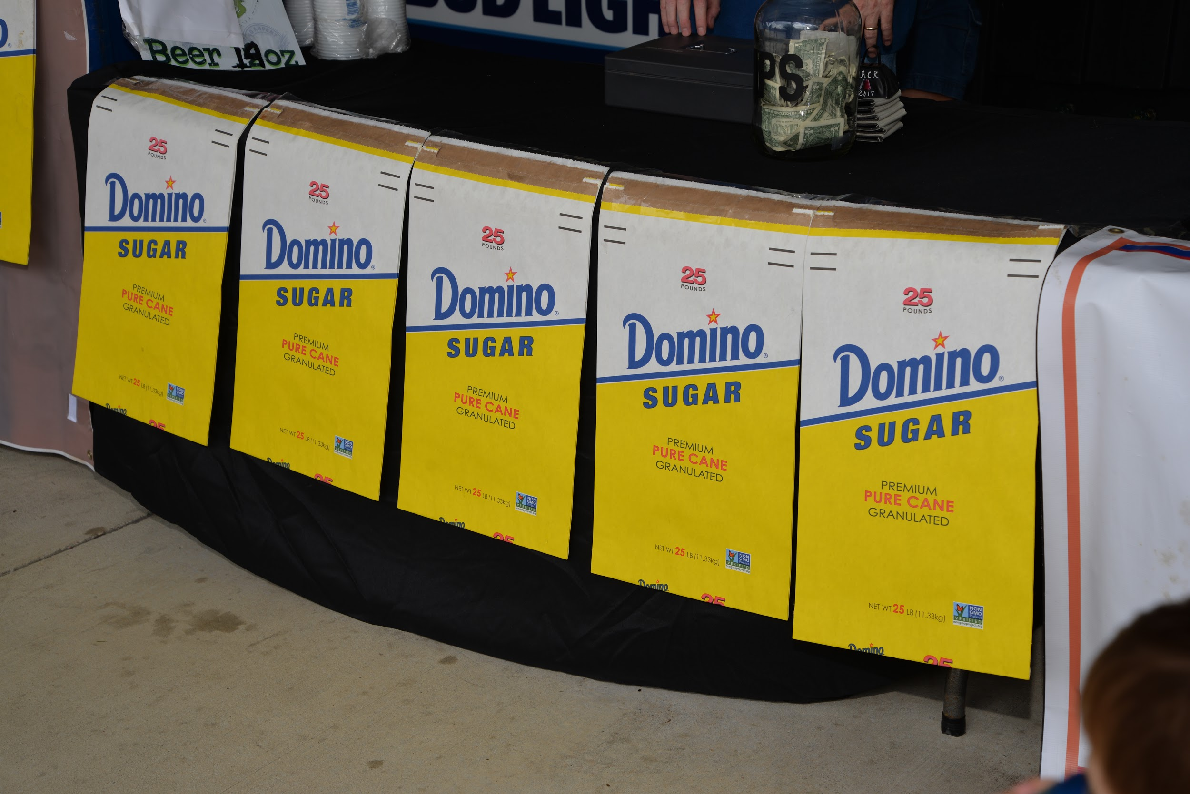
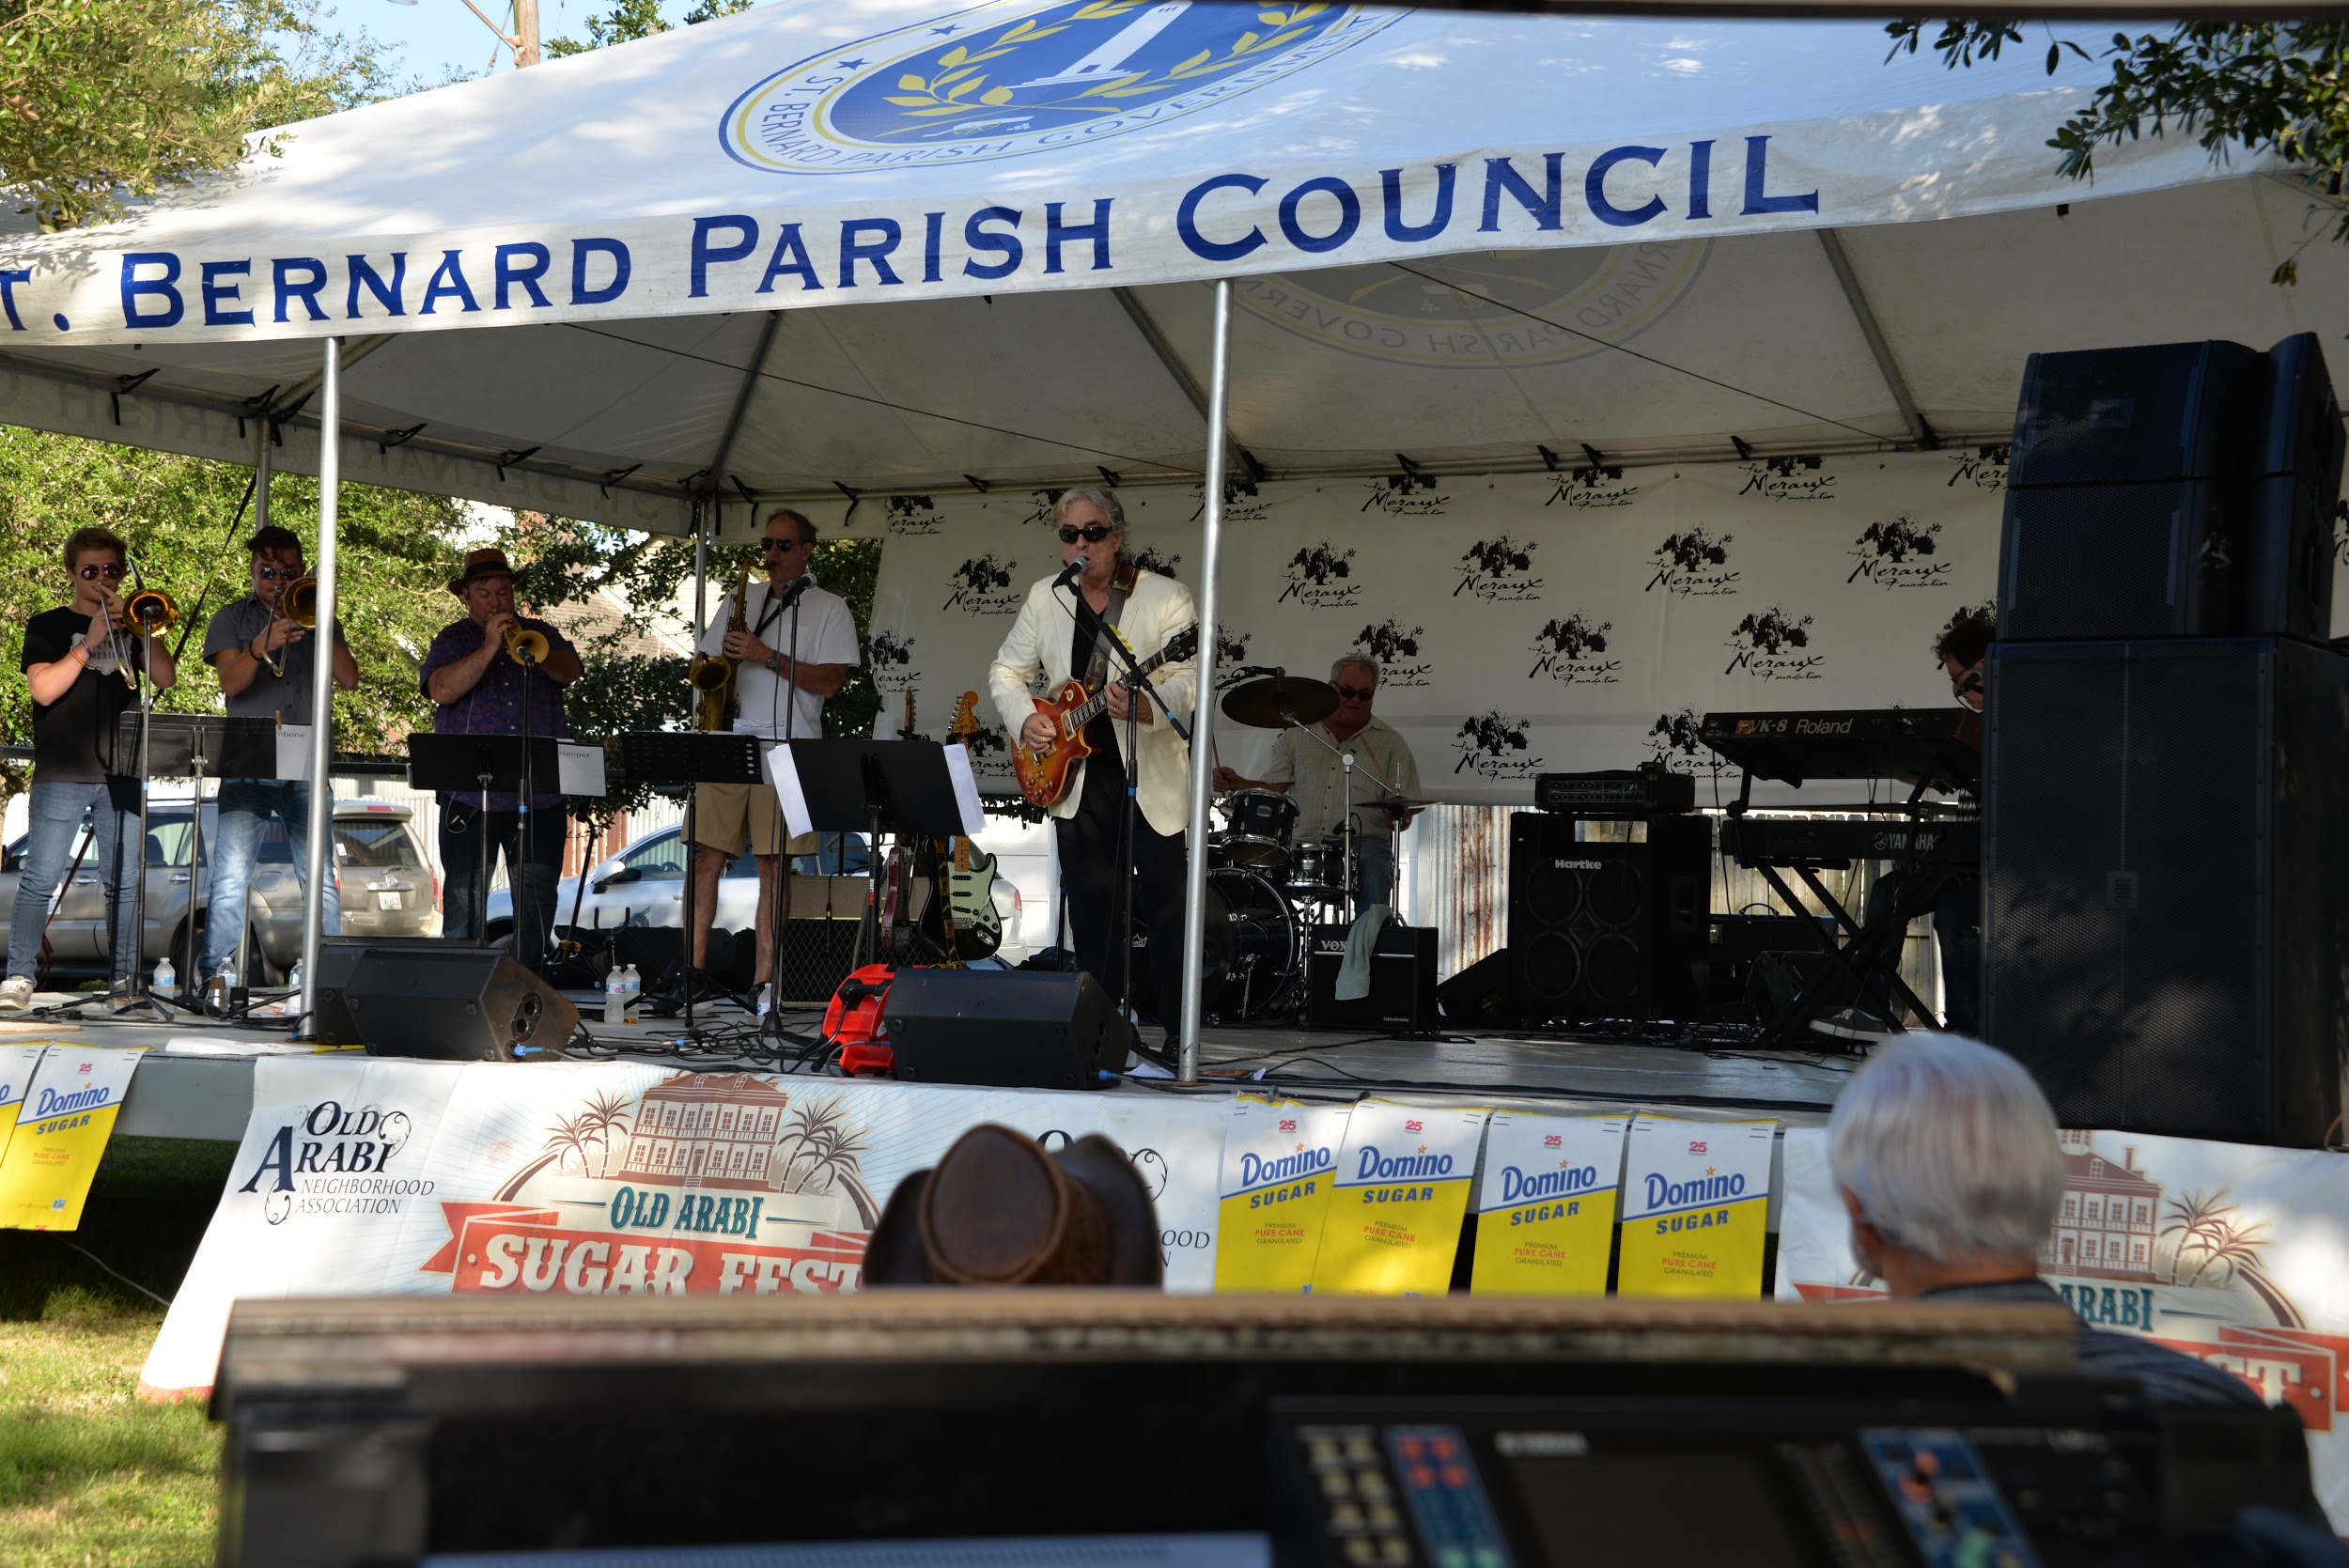
Sugar Fest - Sat.

Slide 10
Some Unique Features
Narrated Tours of
Old Arabi
Dessert Baking Competition
Donut Eating Contest
Domino Giveaways

Slide 11

2018 Sponsor List
COMMITTED
Domino Sugar 5000
Meraux Foundation 2500
Arabi Food Store 250
IN HAND
Fradella’s 100
Tourist Commission 500
Darren Roy 250
Meyers Warehouse 500
Barrios Real Estate Group 250
Rustic Barrel Men’s Salon 250
Dan Johnson CPA 100
IN KIND
Sidney Torres
Gulf Coast Bank
Abita

Slide 13
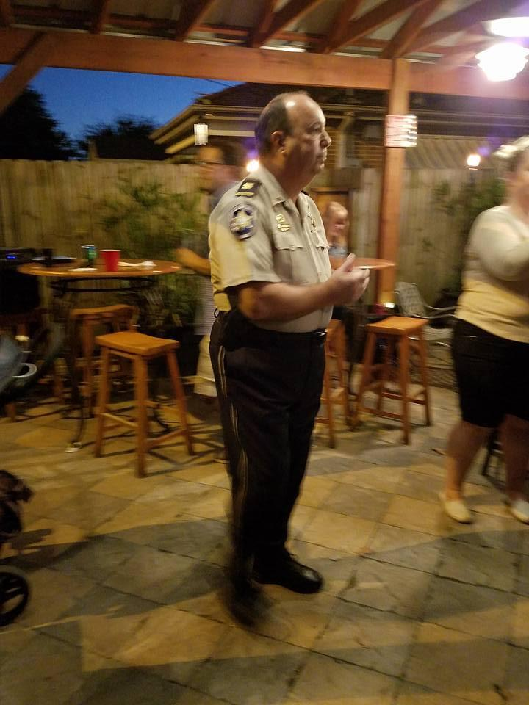
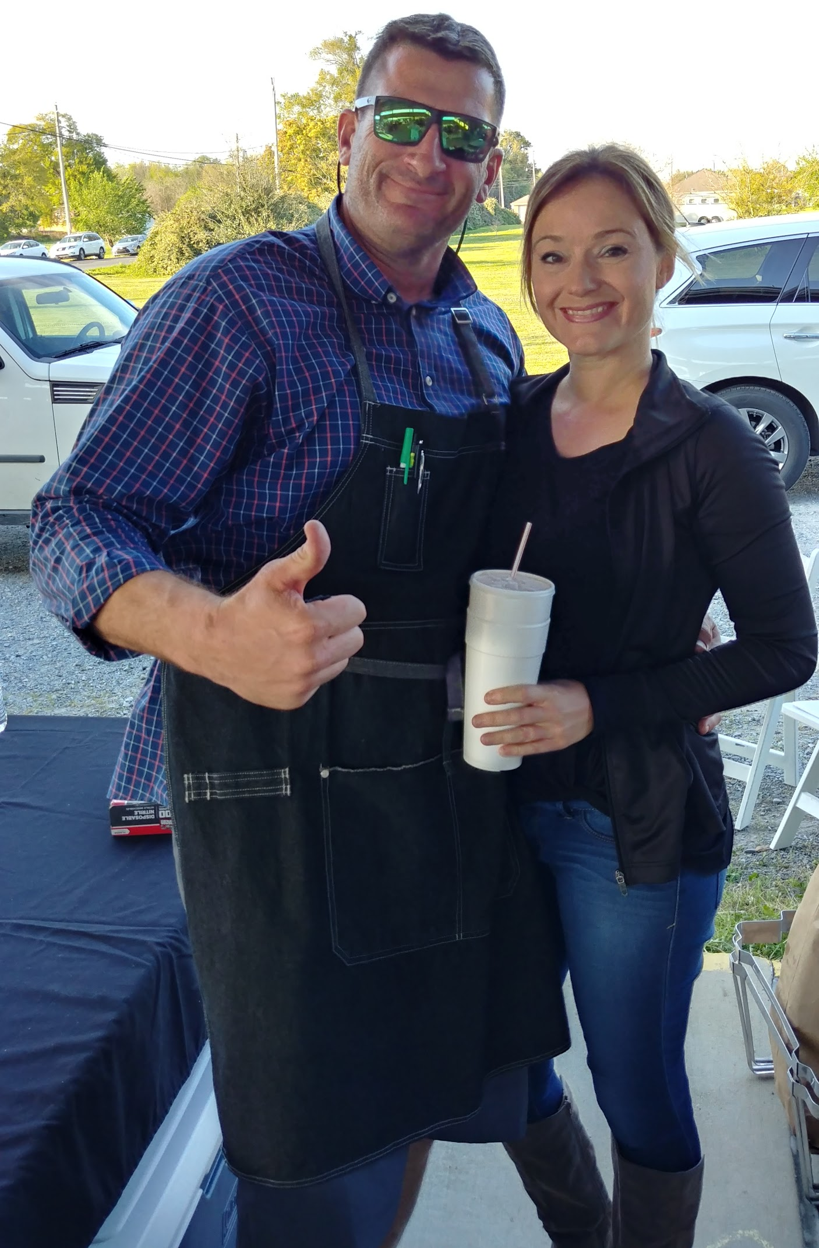

NIGHT OUT AGAINST CRIME
Tuesday, October 16
Arabi Food Store Patio
6 - 8 pm

Slide 14
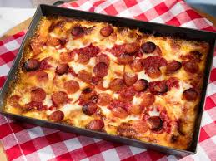
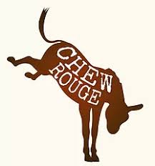
The Answer You’ve Waited For
Detroit-style pizza is a rectangular pizza that has a thick crisp crust and toppings. What makes Detroit-style pizza different from Chicago and New York styles is the crust, which is extra thick and very crispy on the bottom. The rectangular-shaped pizza is the result of being baked in an industrial tray which were originally made to hold small parts in Detroit car factories.

Slide 15
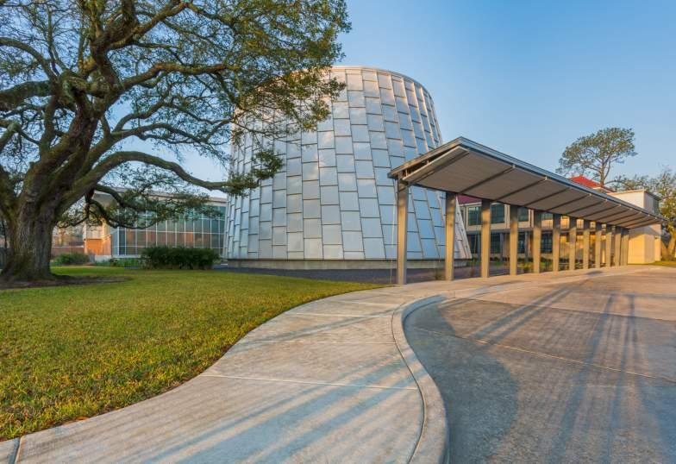
Planetarium Dates
September 19 6:30 pm Black Holes: The Other Side of Infinity
October 13 11 am Zulu Patrol Under the Weather
12:30 pm Habitat Earth
October 17 6:30 pm Dynamic Earth

Slide 16
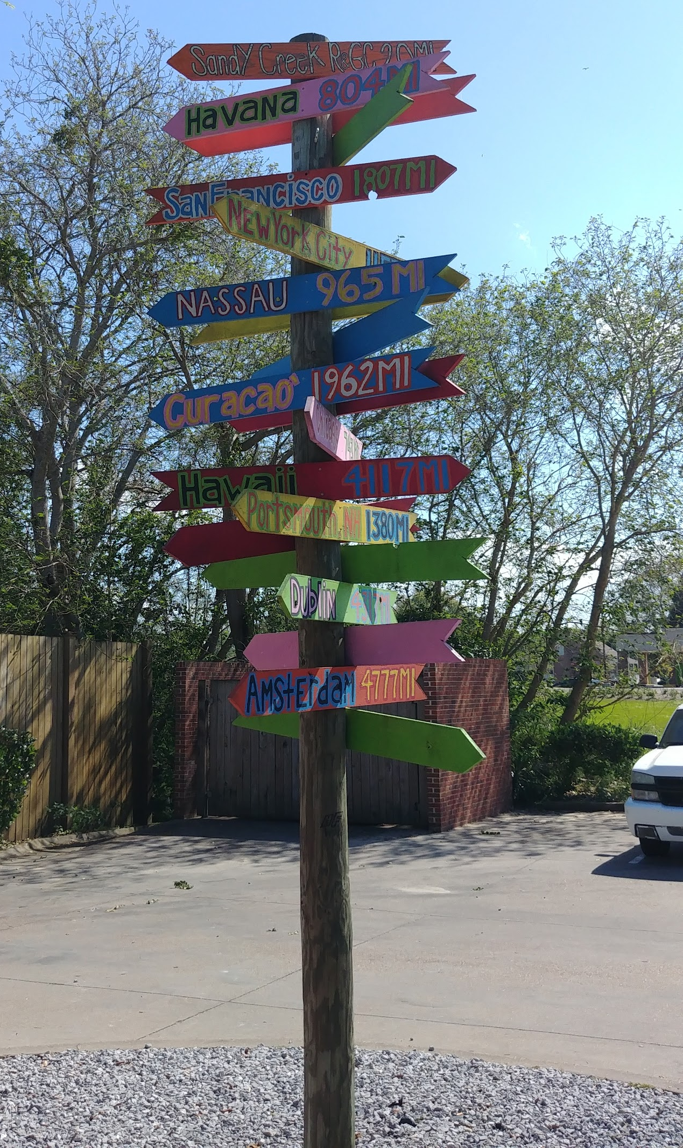
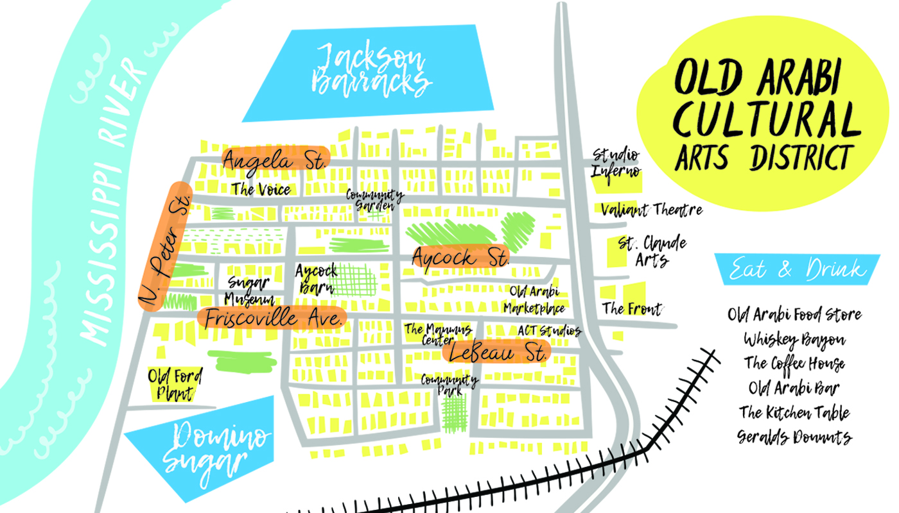
UPDATES

Slide 17
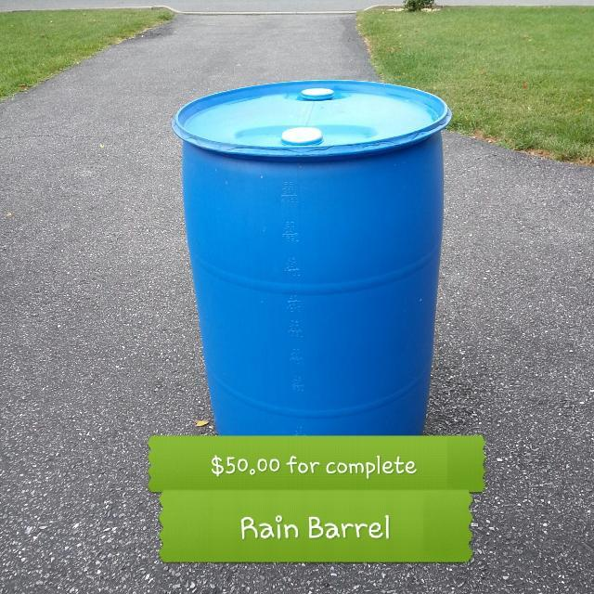
Rain Barrel Project
Making it Rain!
Profits from the sale of these rain barrels would be used towards the ongoing beautification efforts and support of the Community Garden

Slide 18
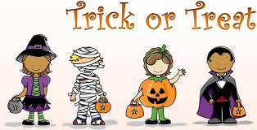
Trick or Treat Participants
A suggestion was made that if you do give out tricks or treats on Halloween night that we create a map of “candy friendly” homes in the neighborhood, so that families can visit those homes.
It would be a way of communicating with friends and neighbors and may make the evening more kid-centered.

Slide 19
DOOR PRIZE & THAT’S ALL FOLKS
Thank you for being here tonight and for your involvement in OANA.
Thanks Gena for hosting us.
Sippin in the Sunset Sept 20
Sugar Fest October 13
Night Out Against Crime October 16
Don’t forget to VOTE November 6

