Slide 1

Old Arabi Neighborhood Association Meeting
November 2018

Slide 2
AGENDA:
Pledge
Shop Small / Community Garden
Upcoming Sippin
Sugar Fest 10 Update
Night Out Against Crime
Halloween / Garage Sale
Totem Pole Update
Planetarium Show Dates
Upcoming Events
Door Prize / Adjournment

Slide 3
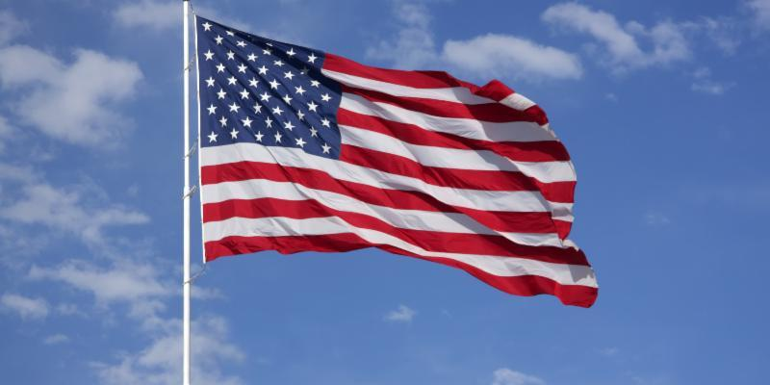
Notes:
Pledge, then year in review

Slide 4


Slide 5
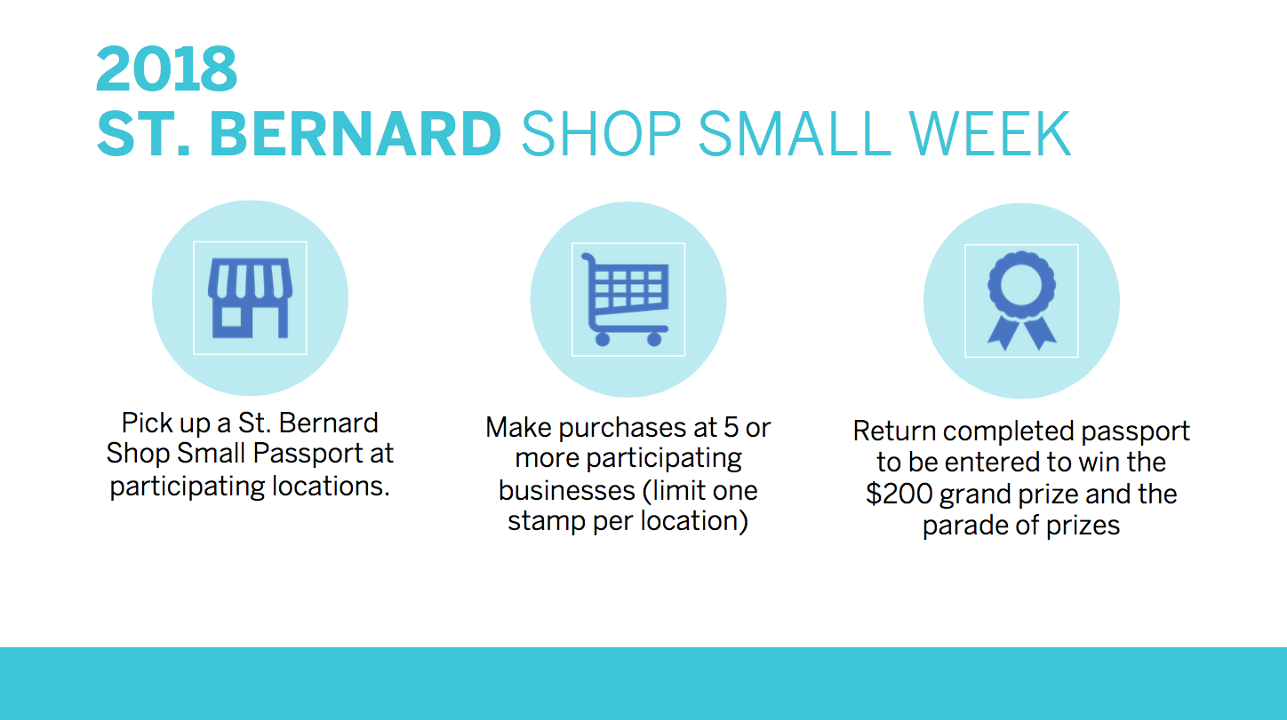

Slide 6


Slide 7
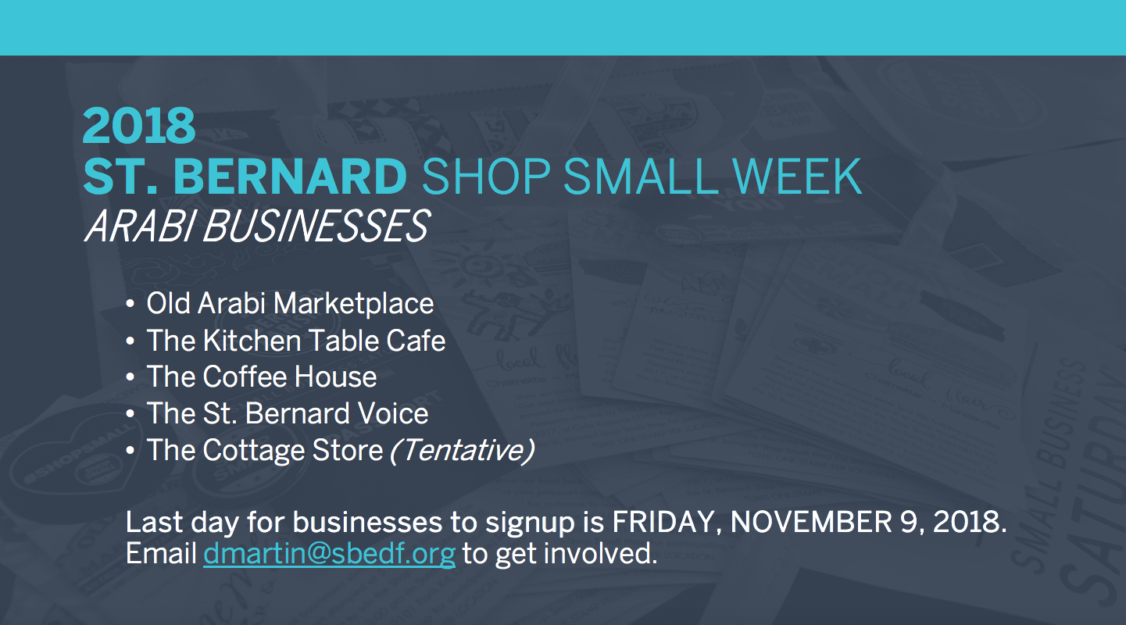

Slide 8
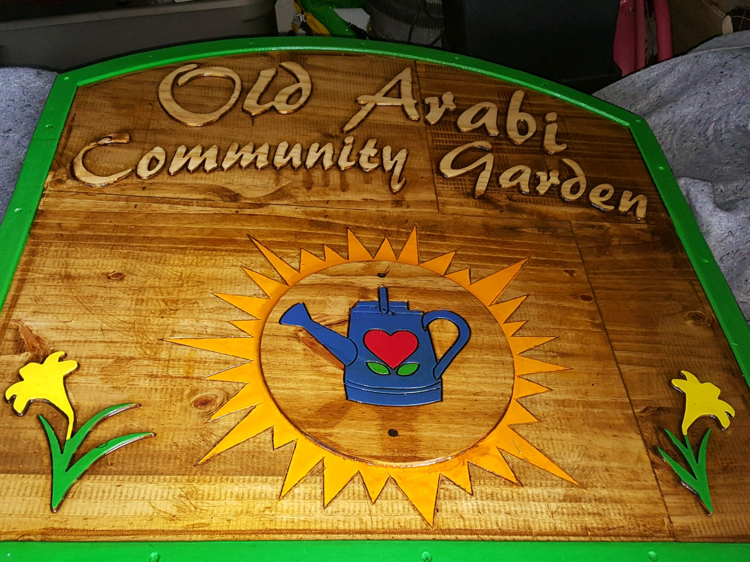

Second Sunday of the Month

Slide 9
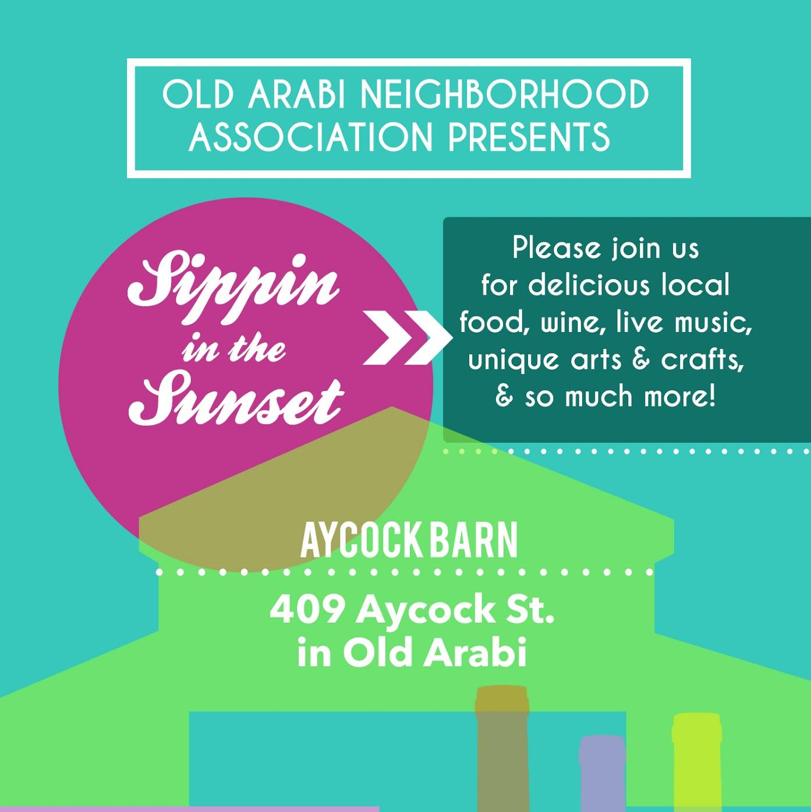
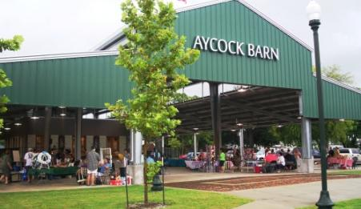
Sippin in the Sunset 2018
ThanksSipping!
Thursday, November 15th 6 - 9 pm at the Aycock Barn

Slide 10
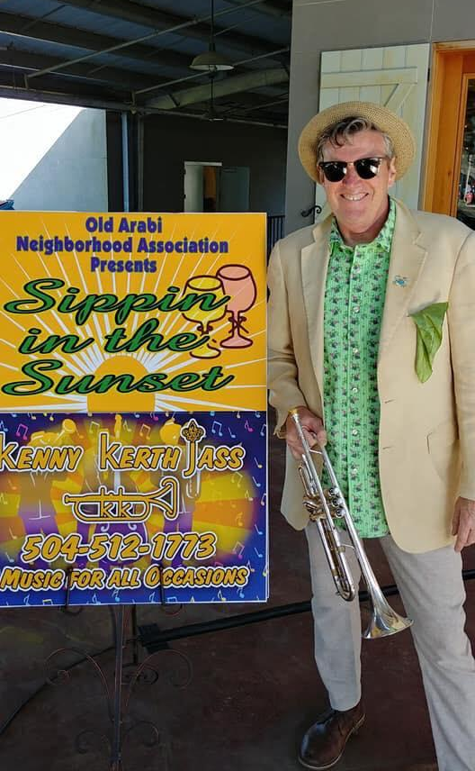

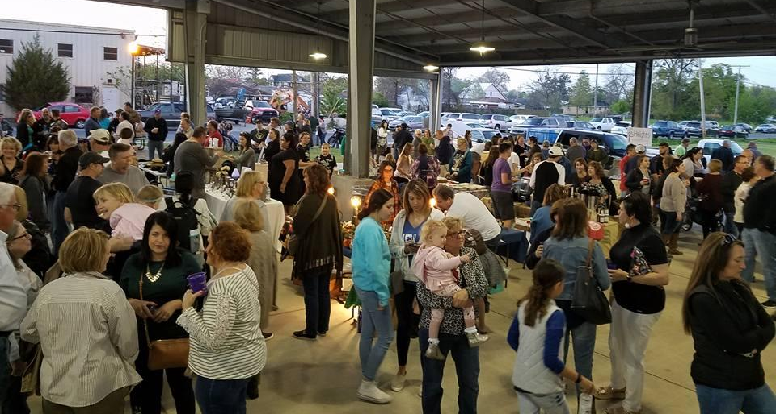
Kenny Kerth Jass, Susan Sangria, and a lot of fun

Slide 11

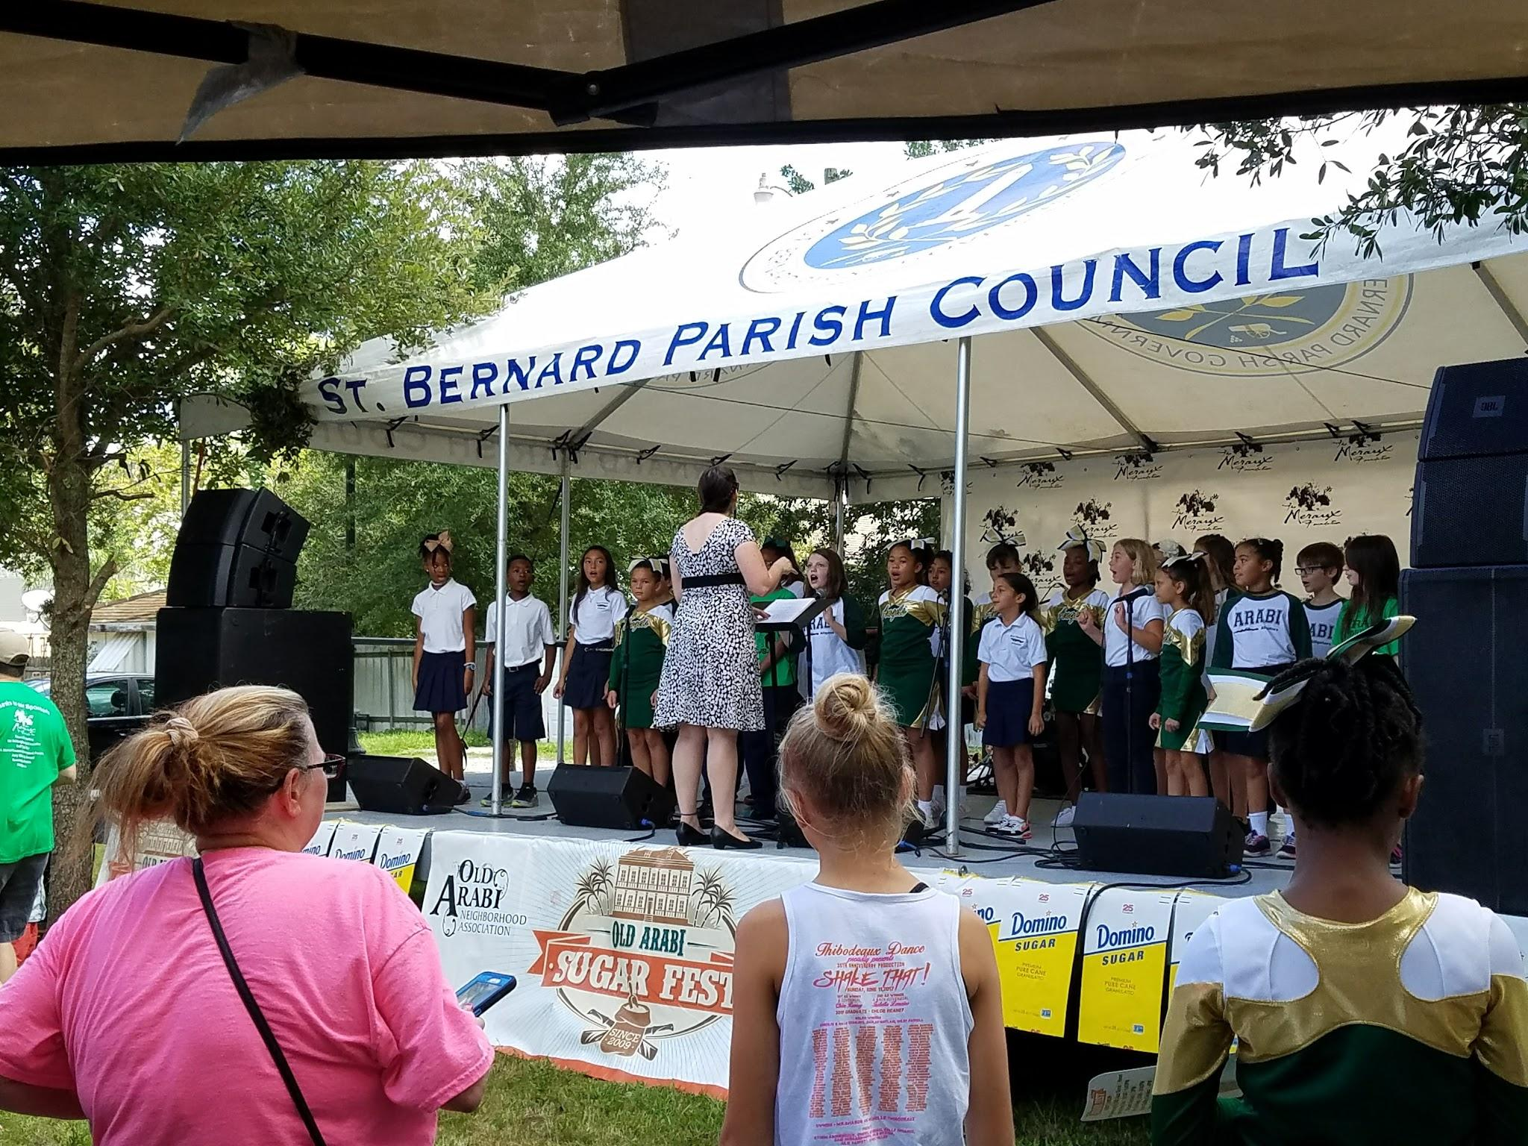
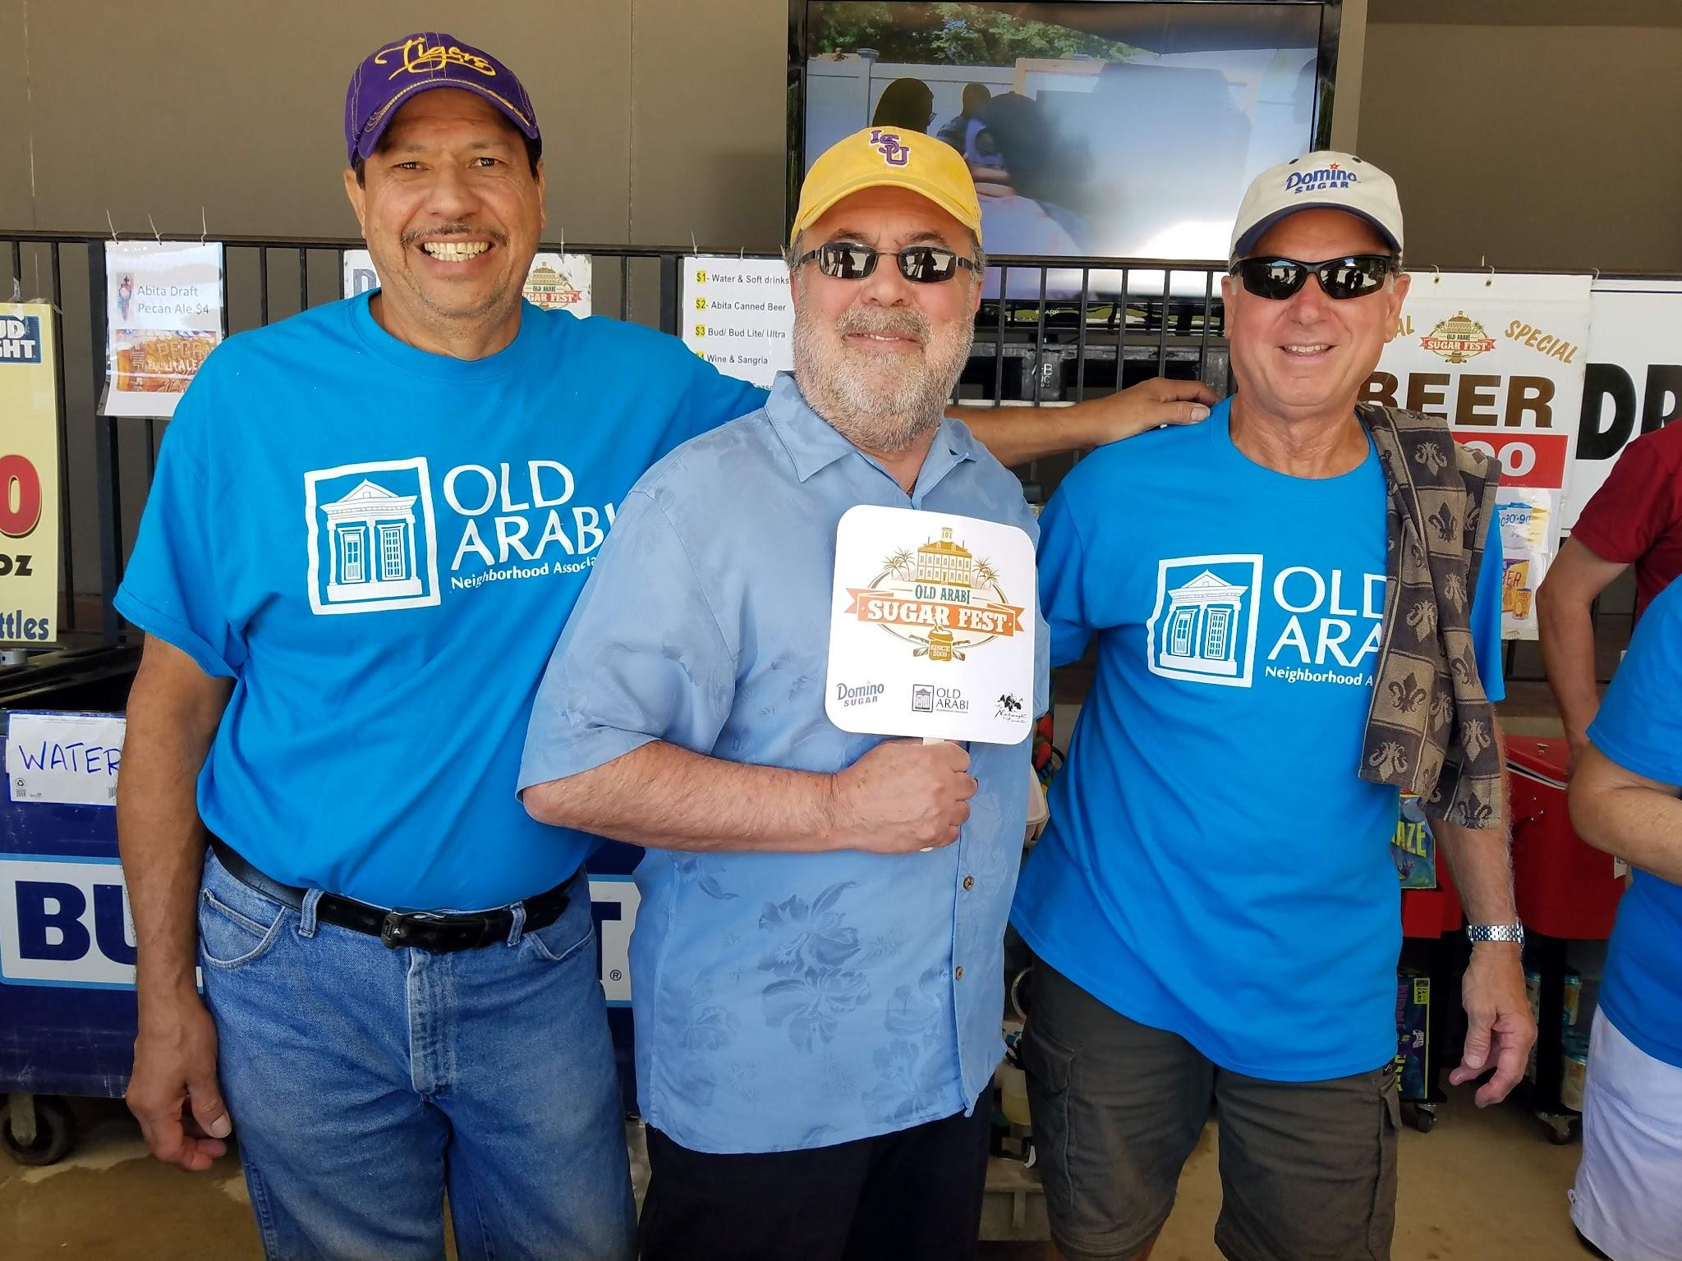
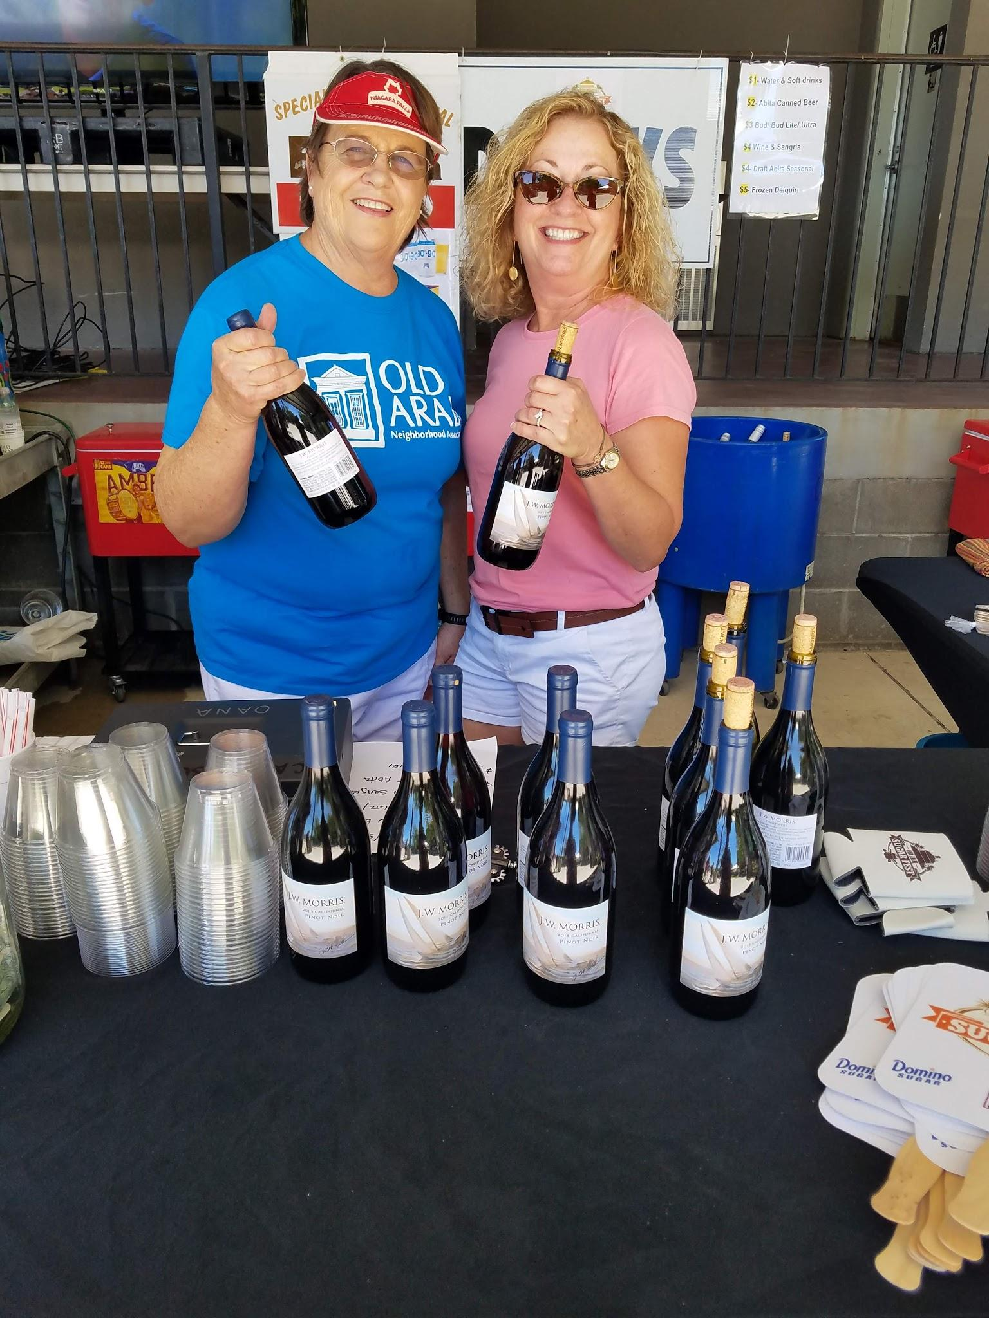
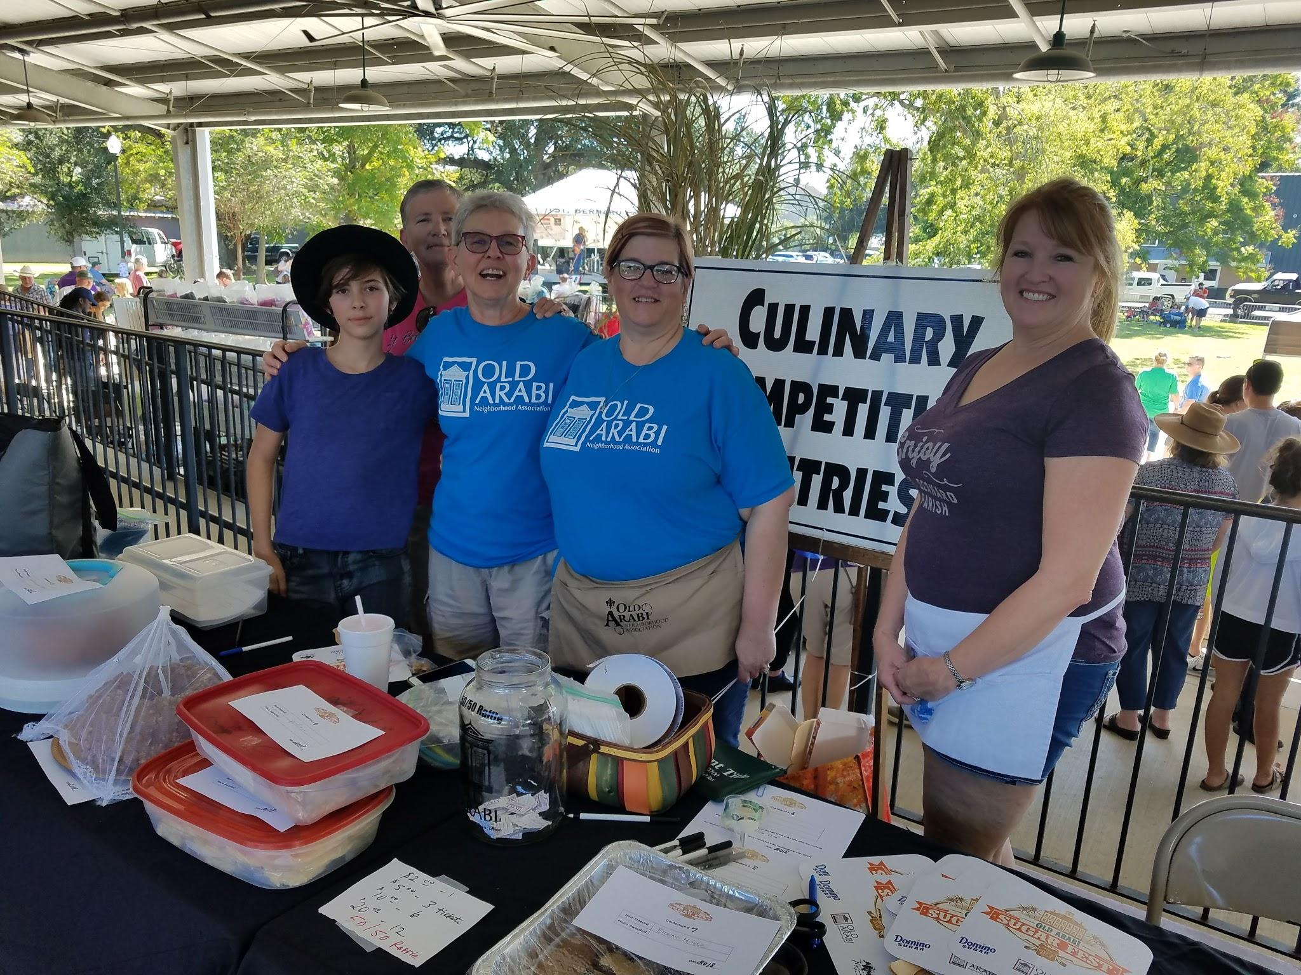

Slide 12
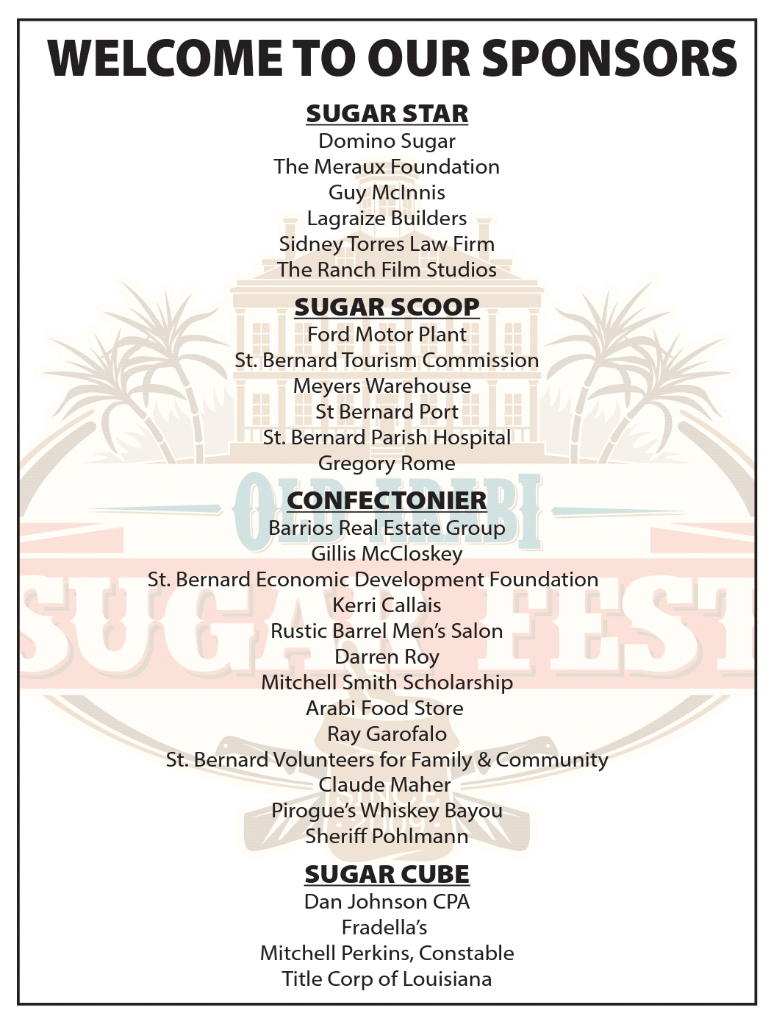
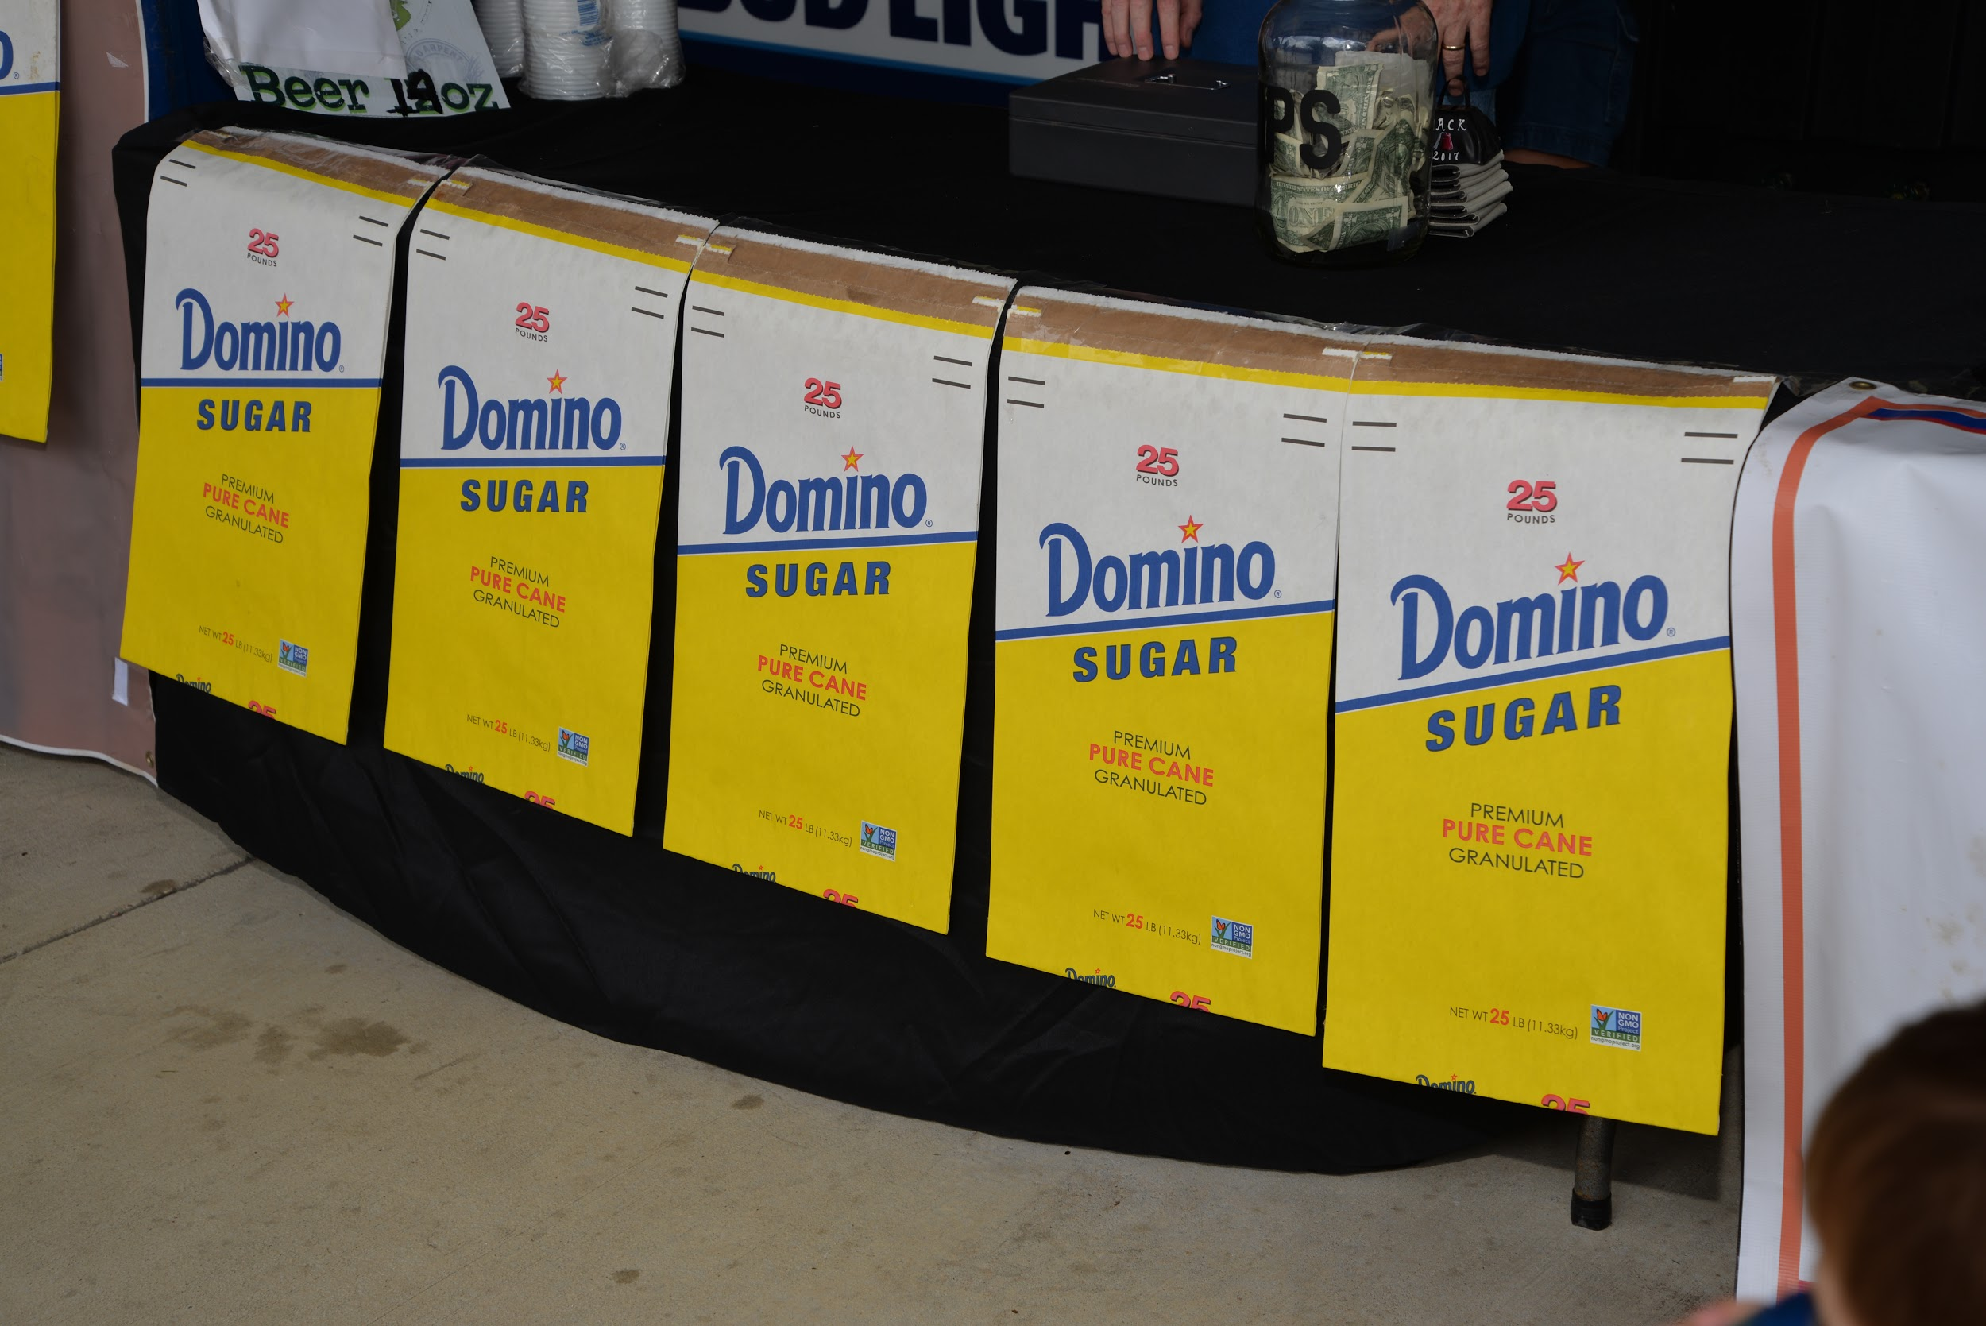
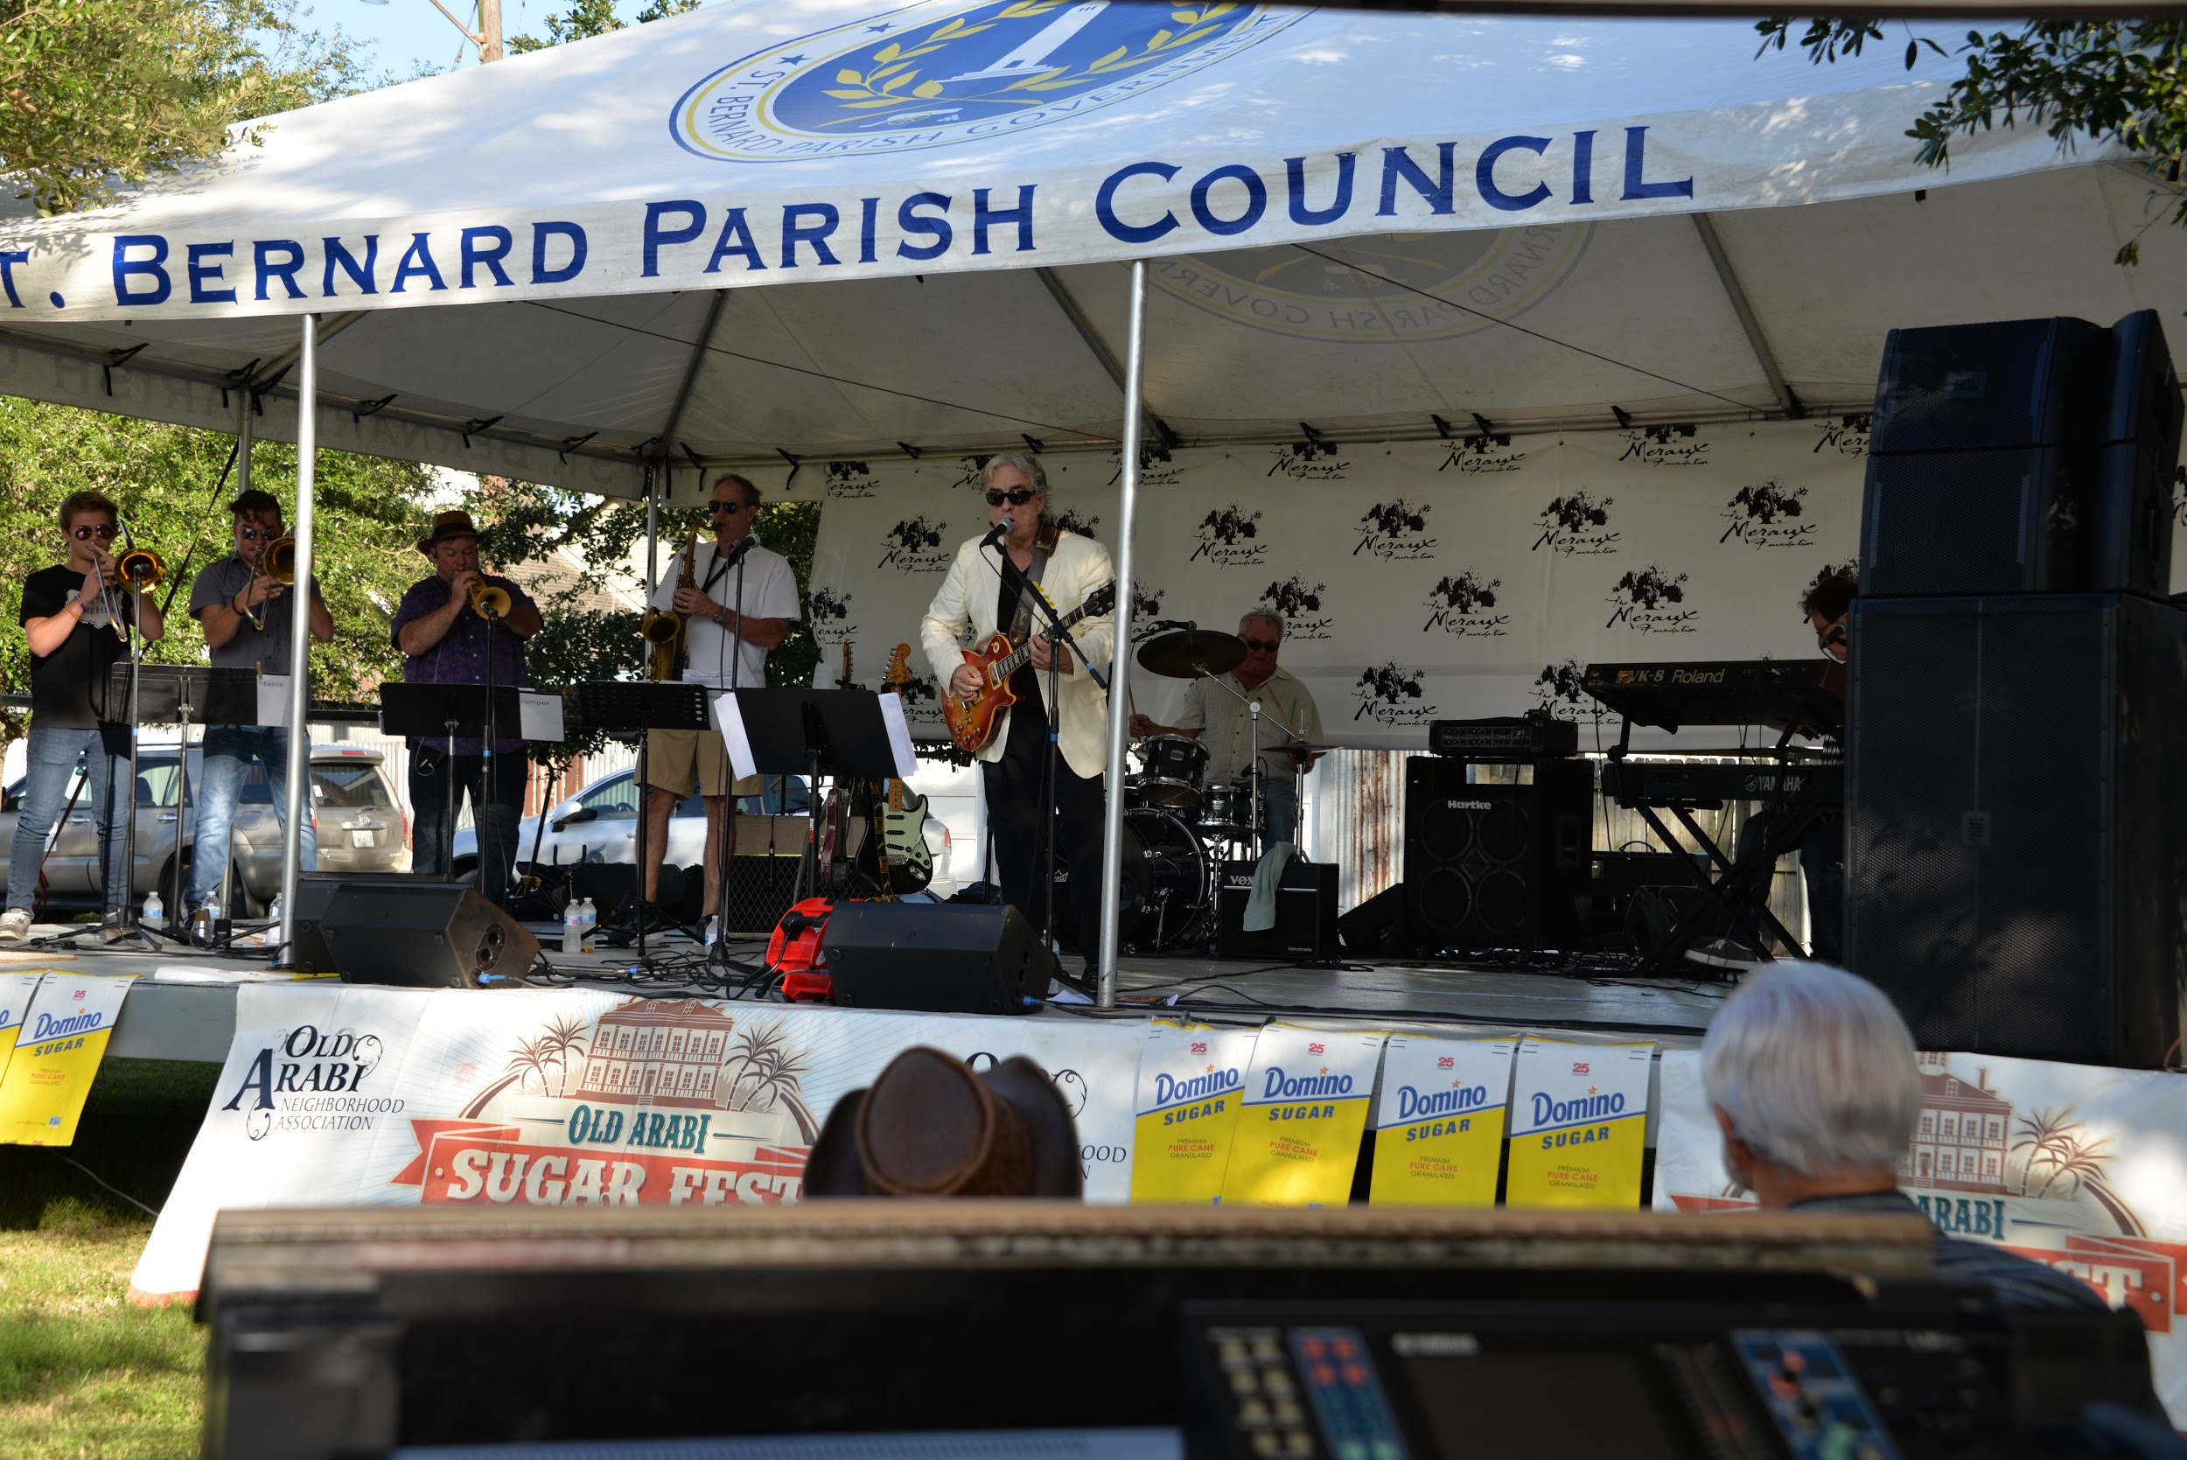

Slide 13
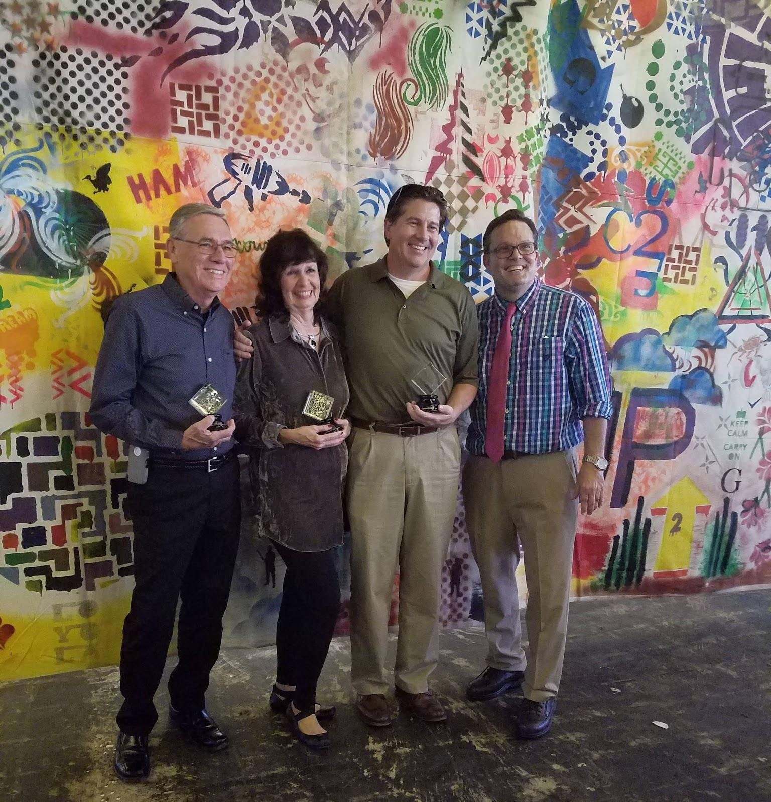
Friend of Old Arabi Awards
A decade of Sugar Fest
Tom Braniff
Ray Lauga
Faith Moran

Slide 14
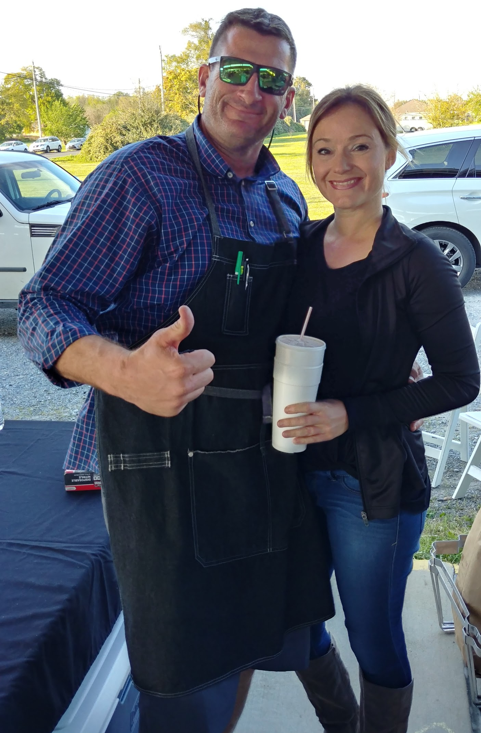
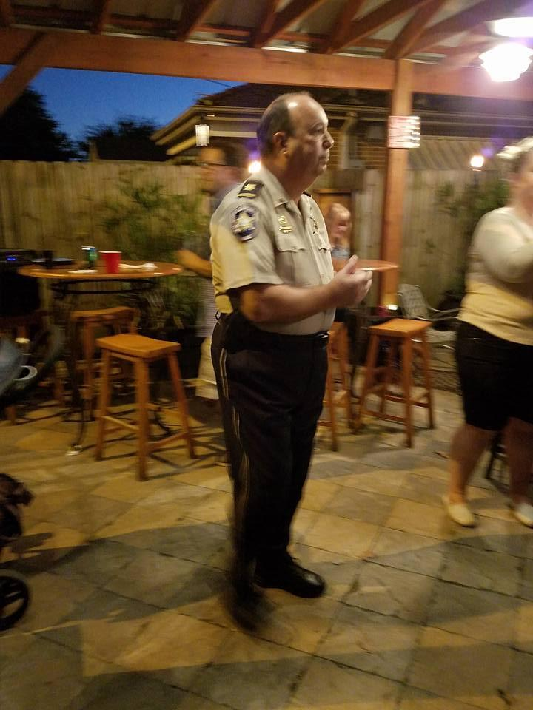

NIGHT OUT AGAINST CRIME
Tuesday, October 16
Arabi Food Store Patio
6 - 8 pm

Slide 15
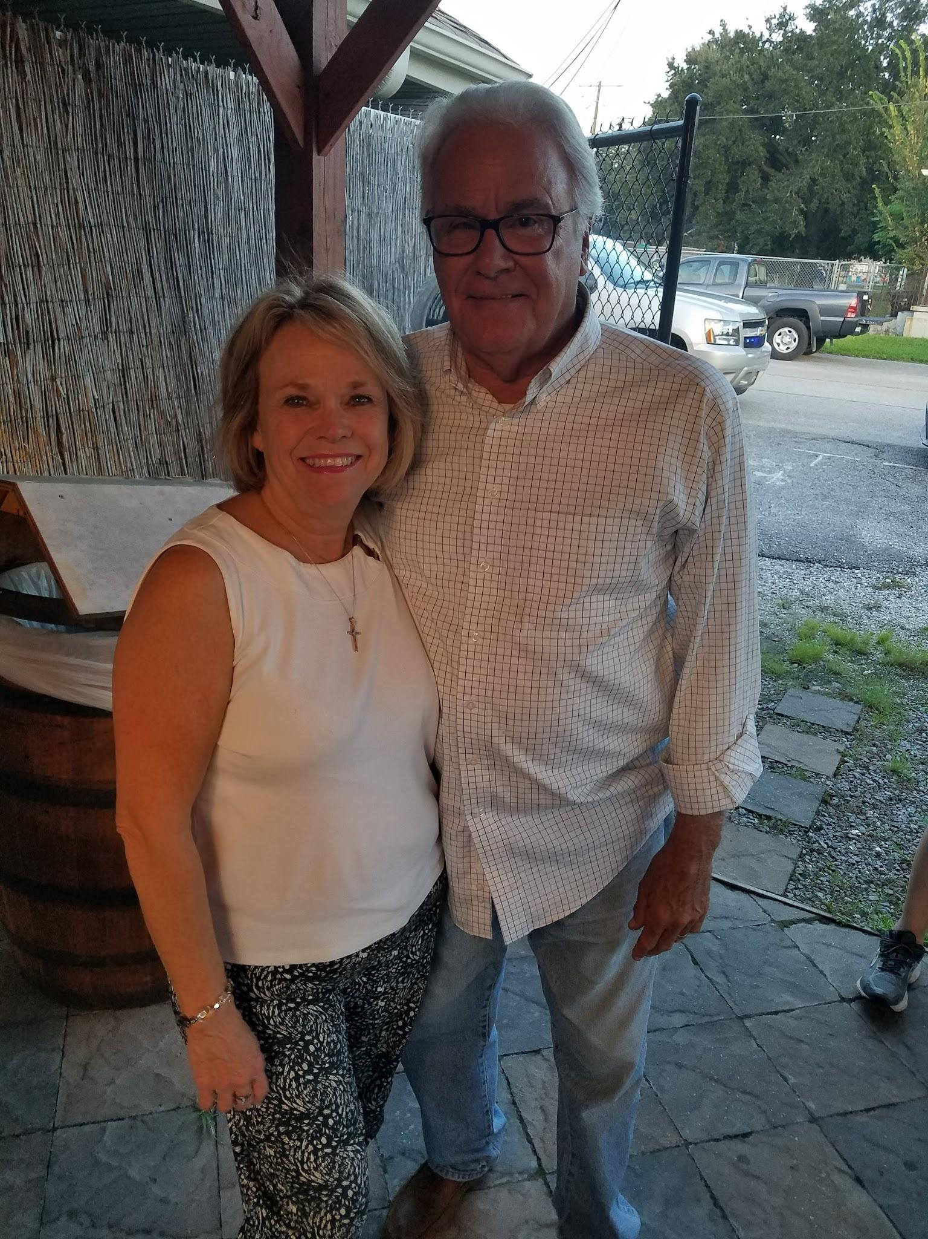
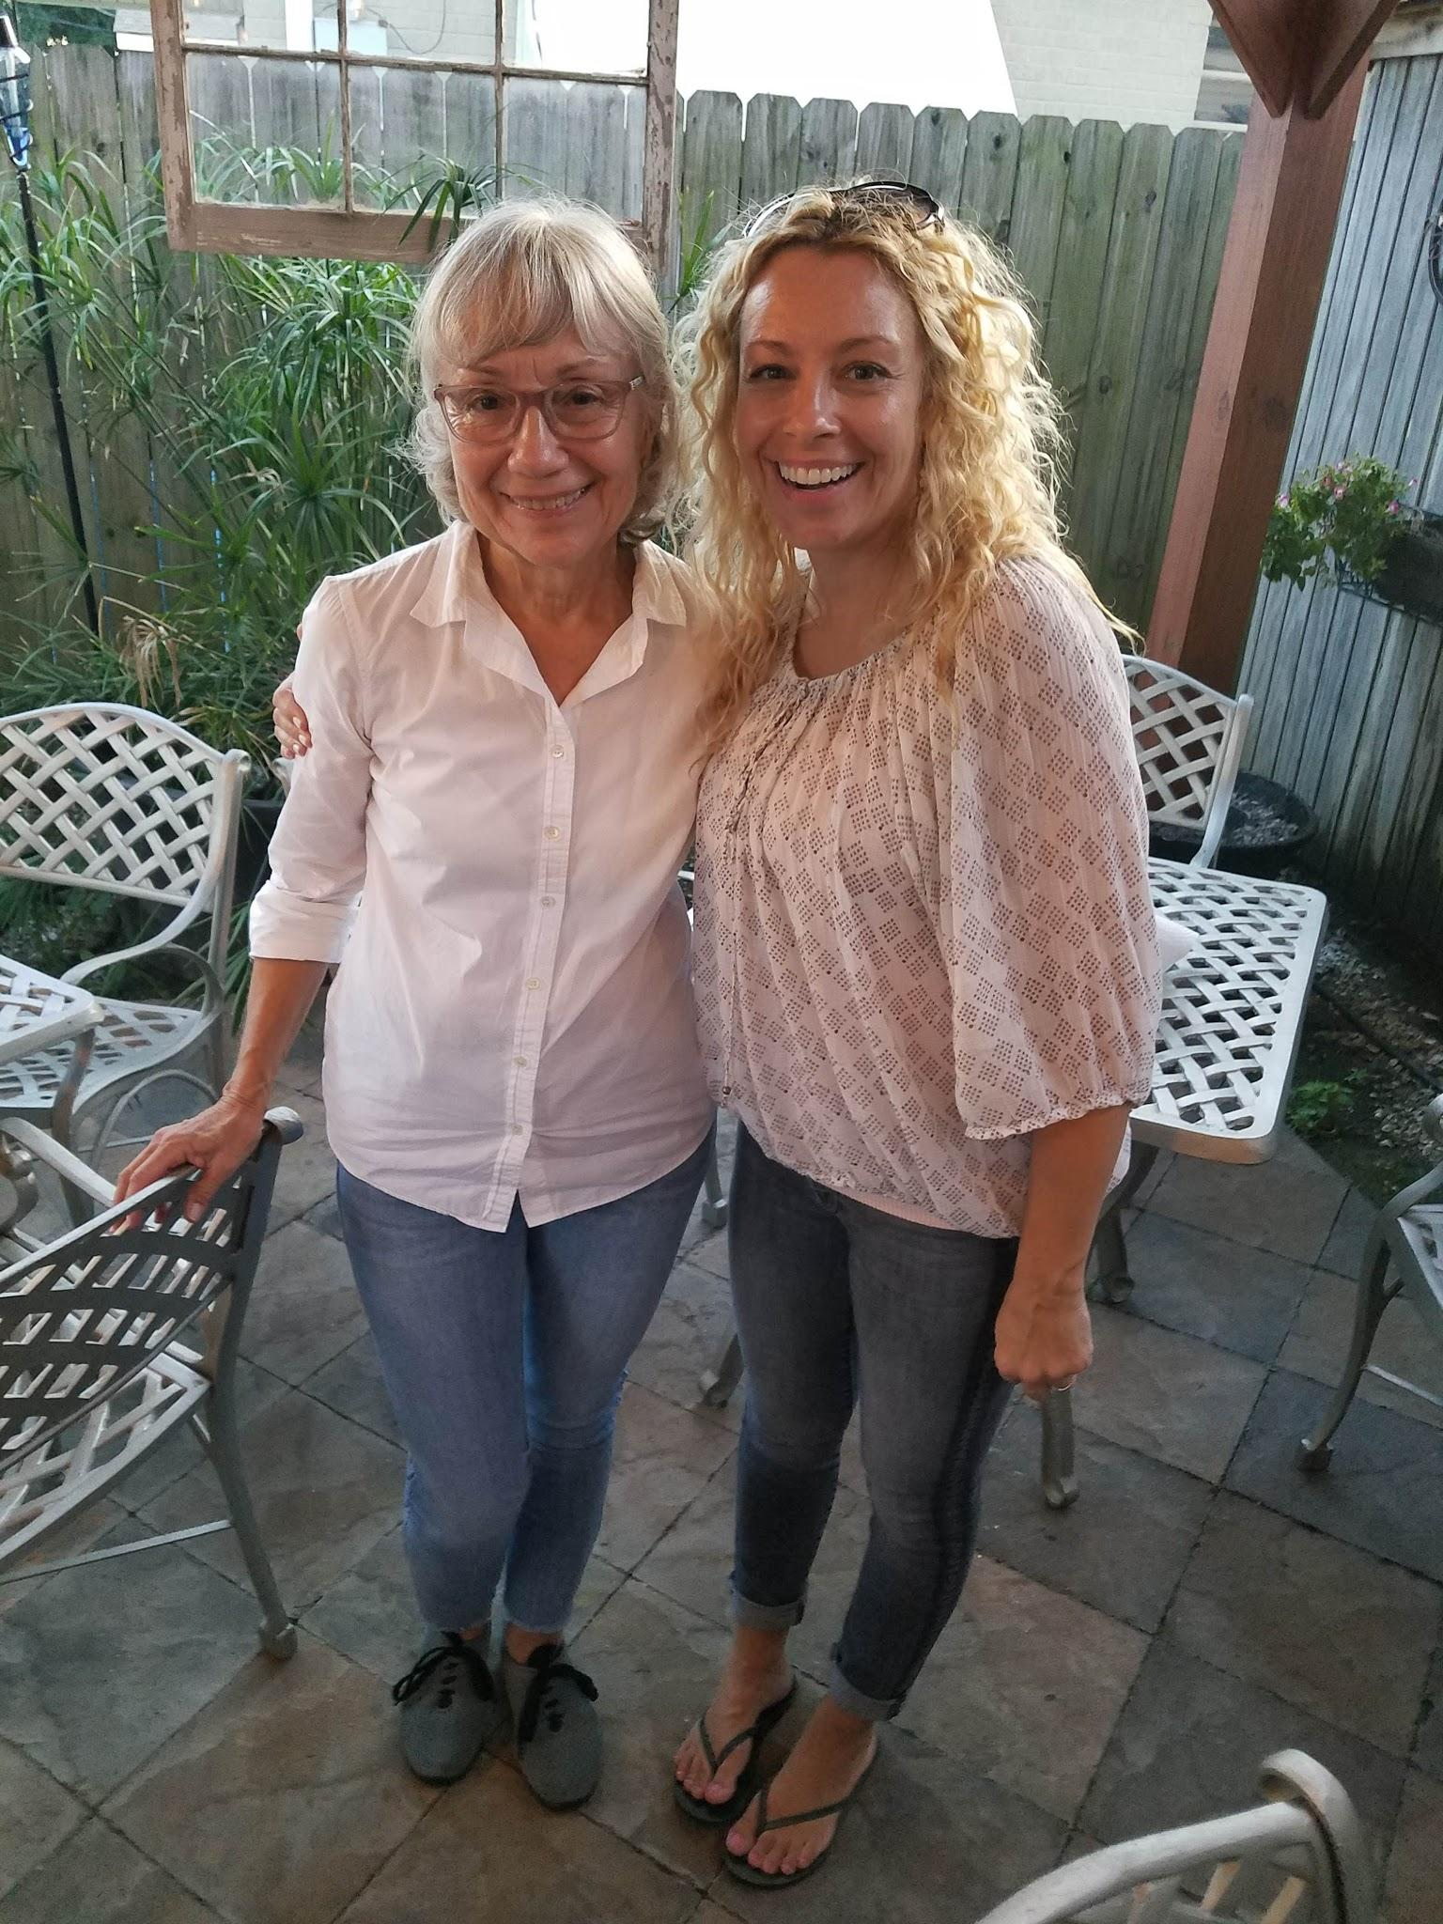
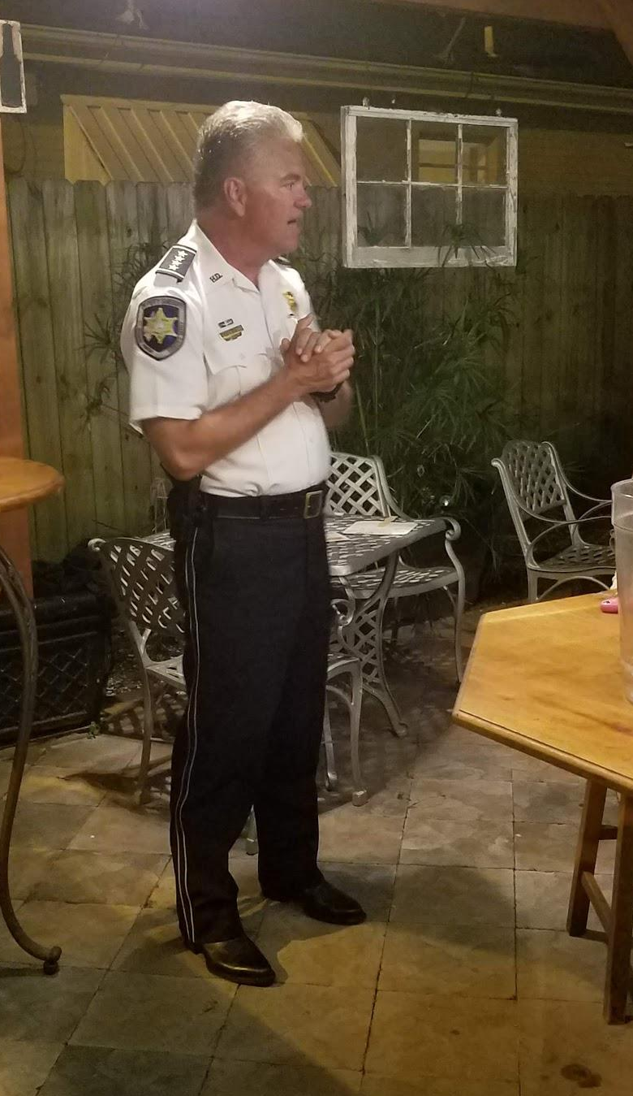
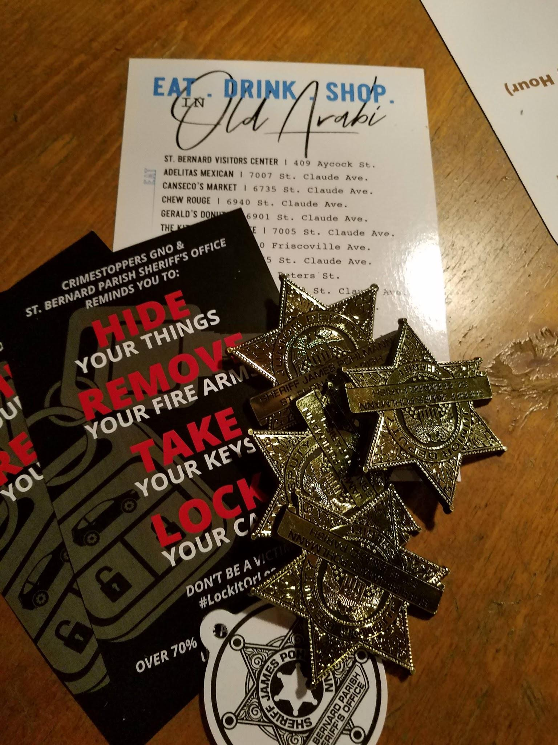
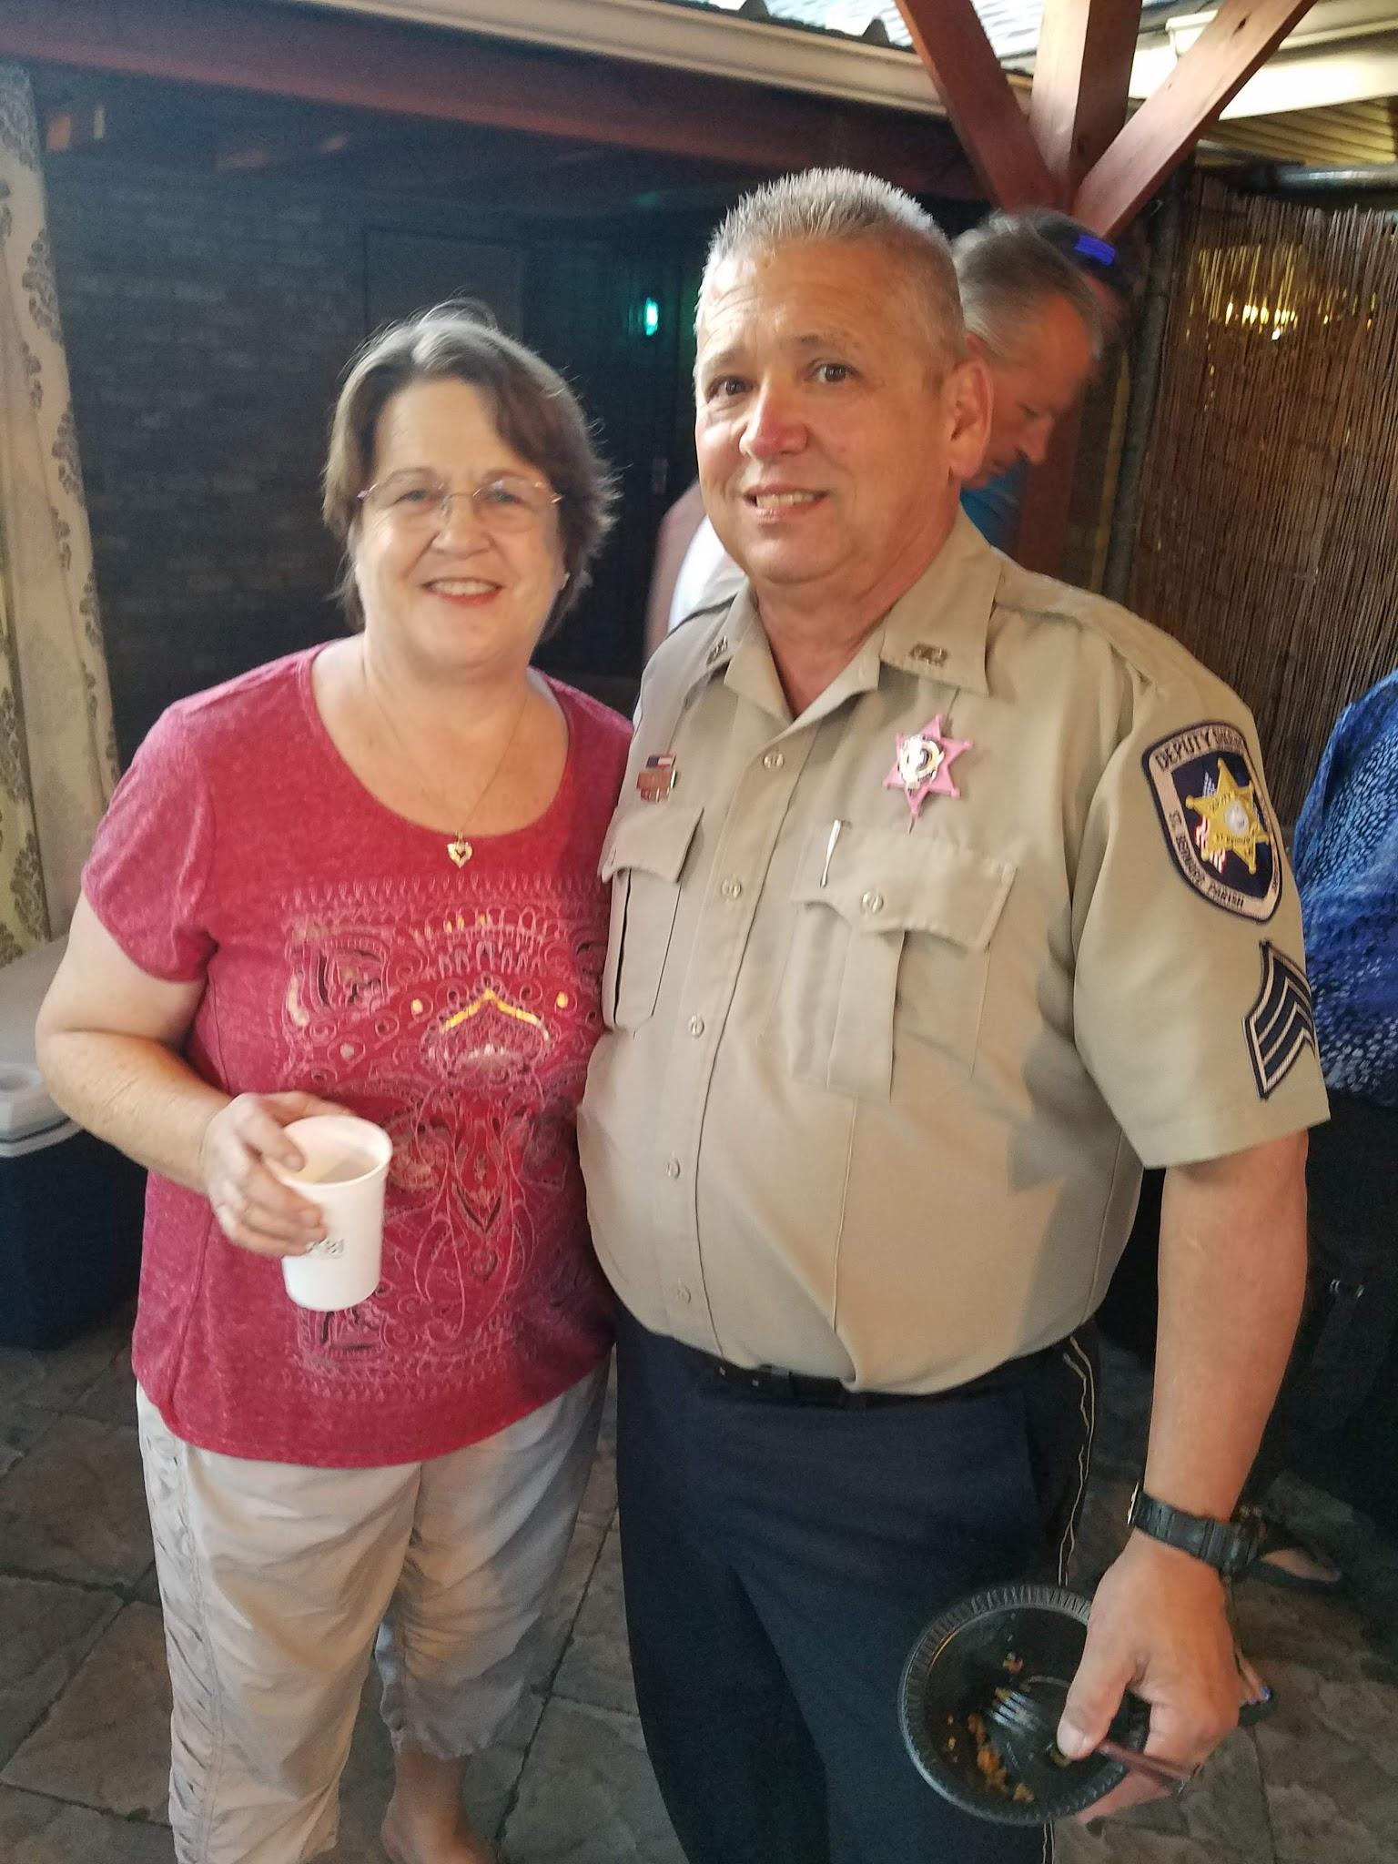
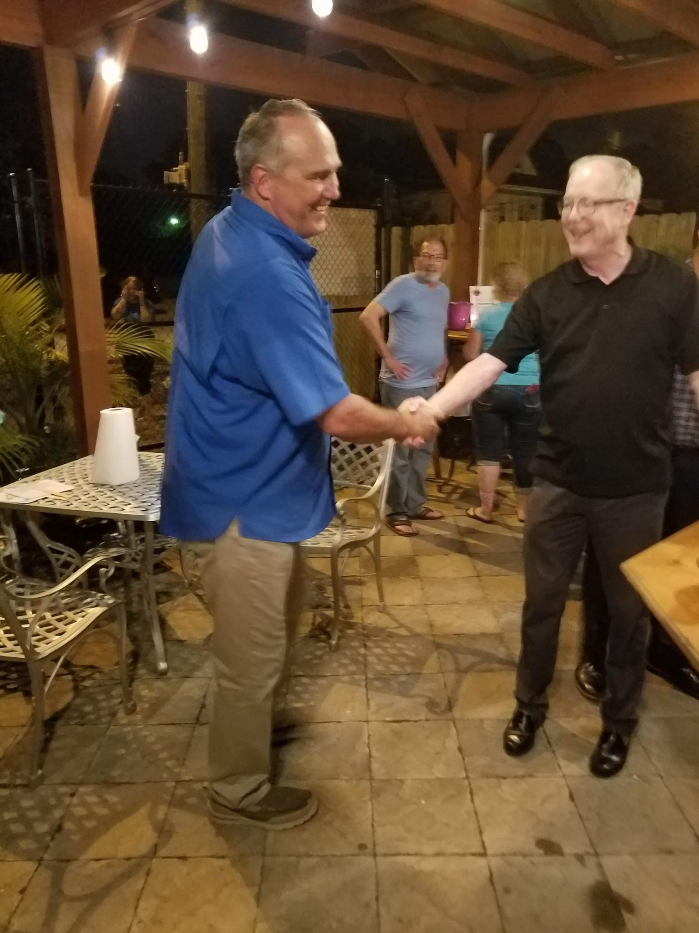
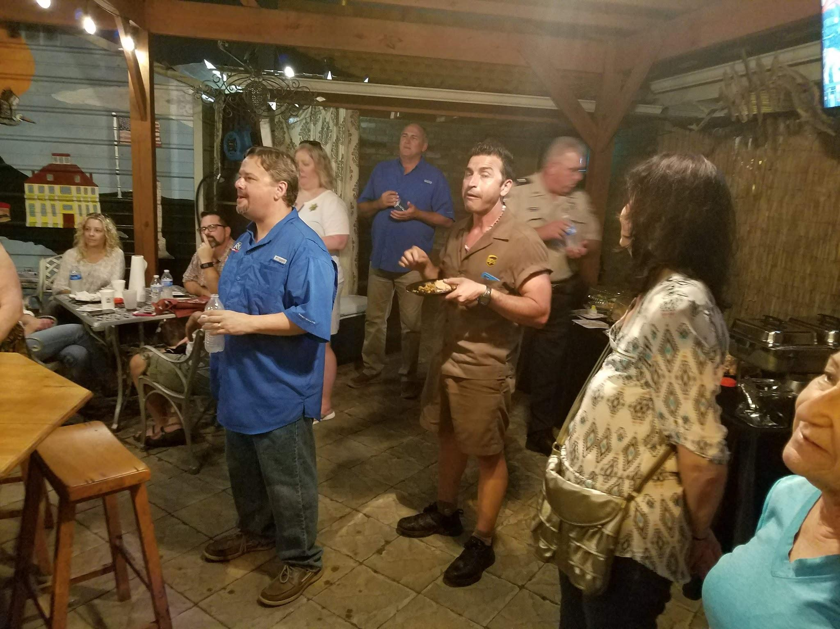

Slide 16
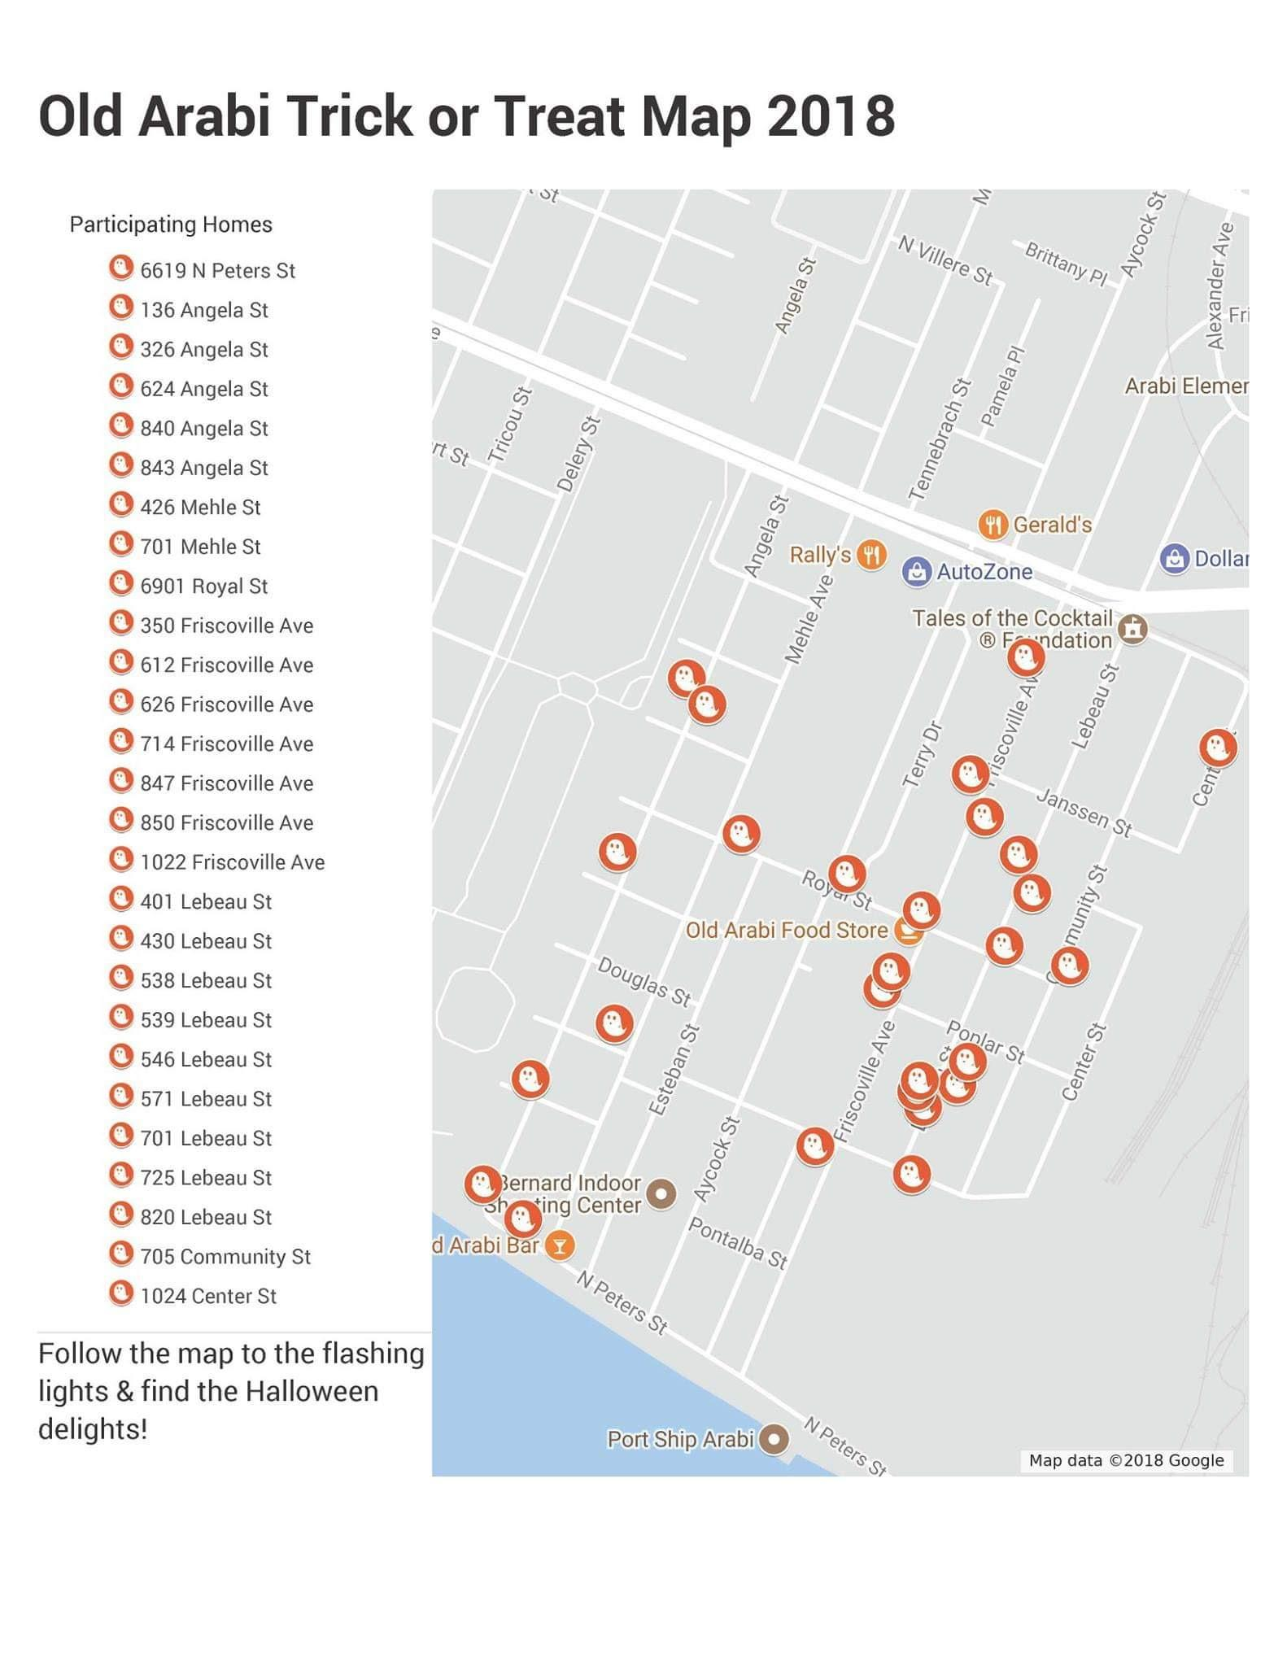
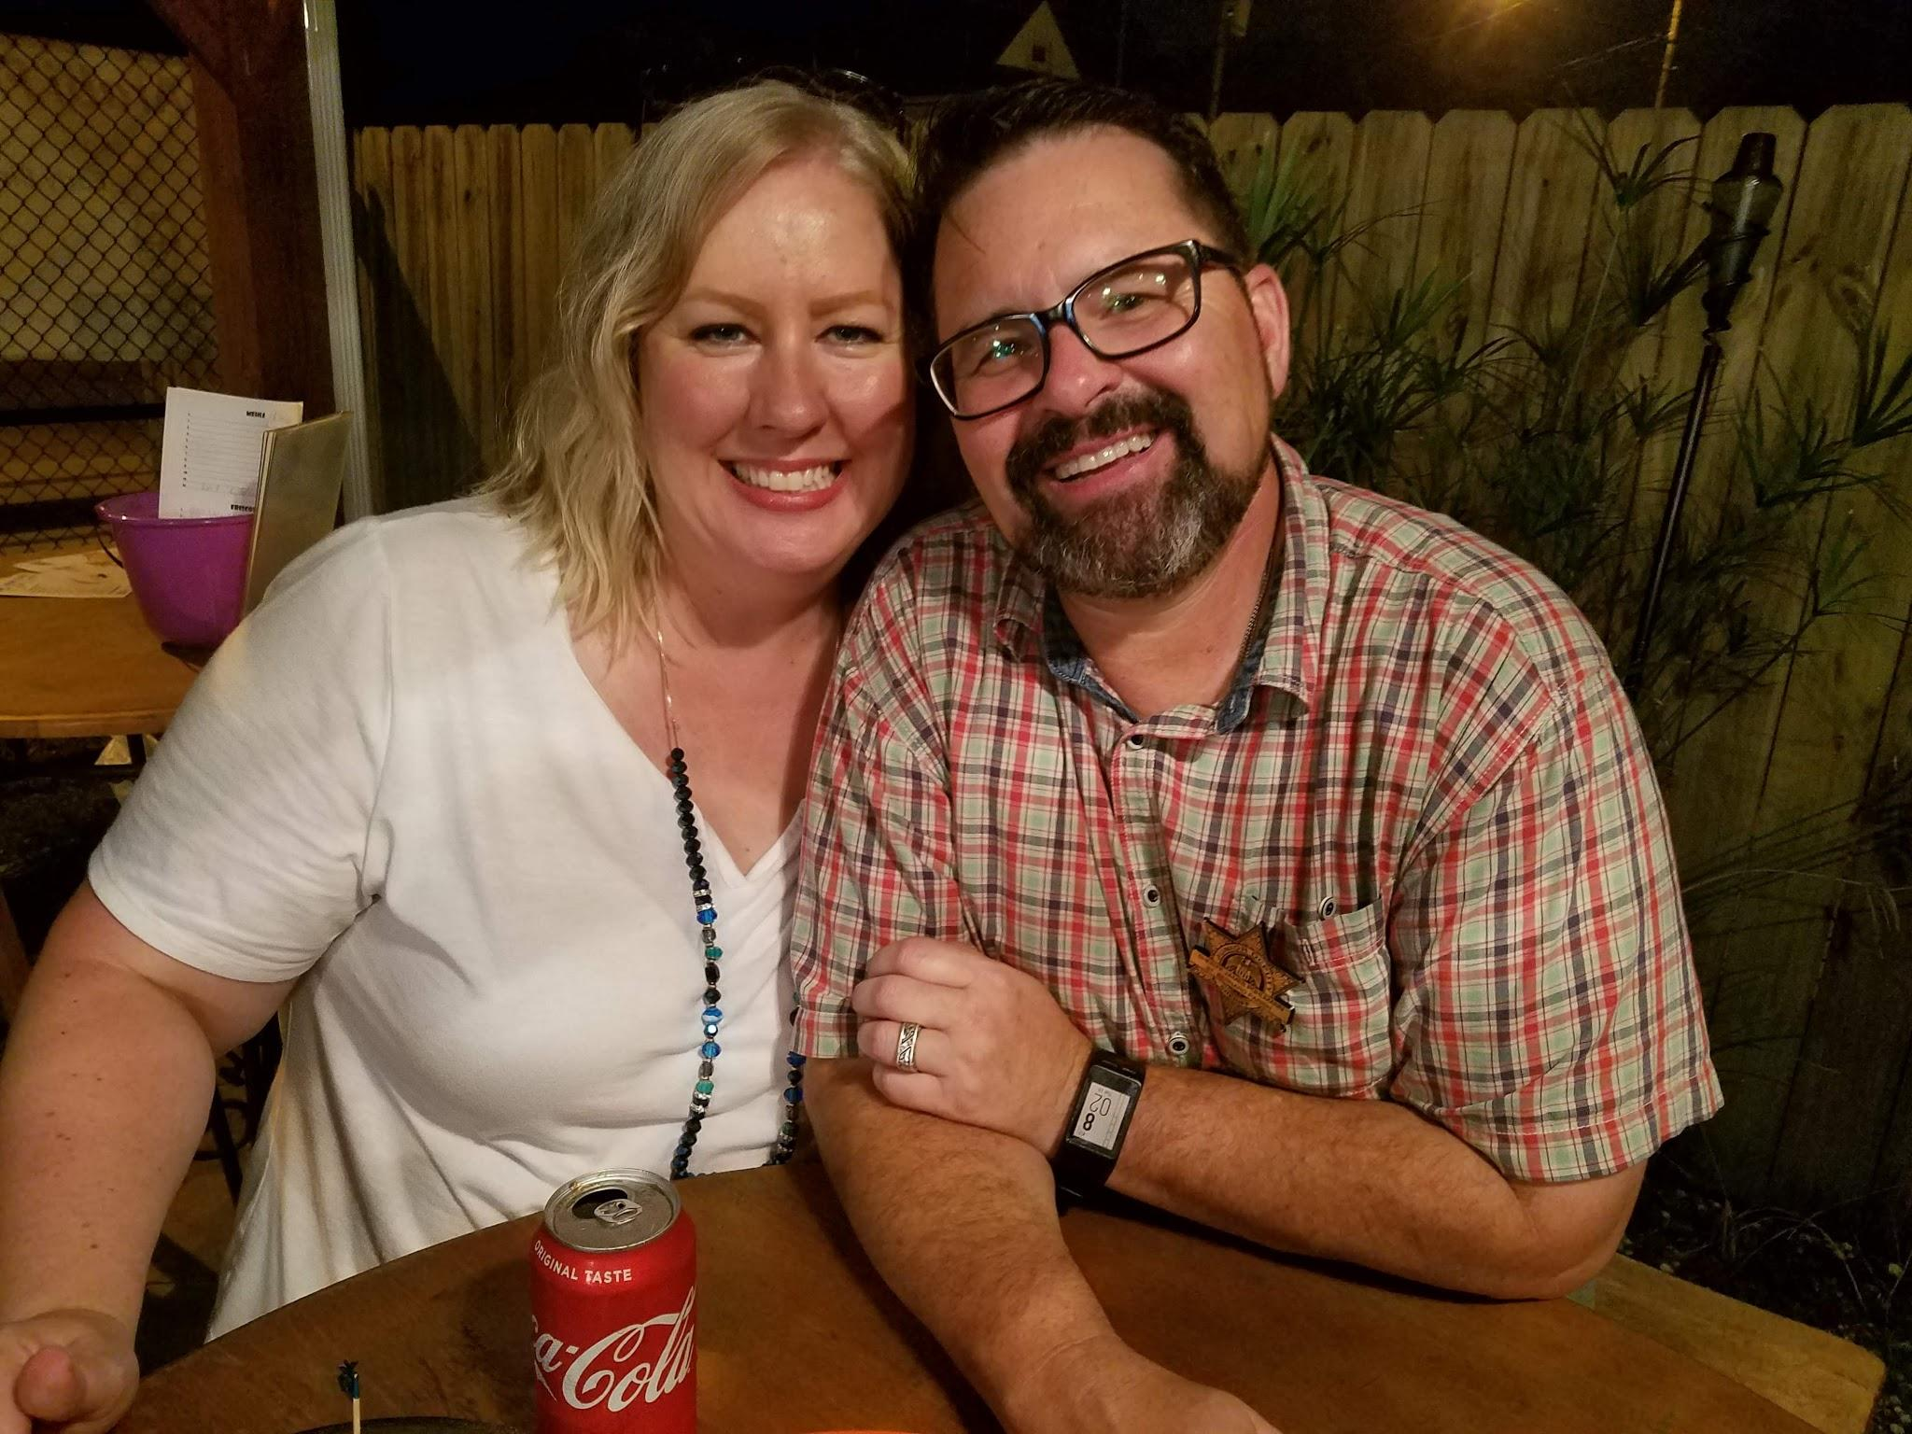
Halloween
Happening….

Slide 17

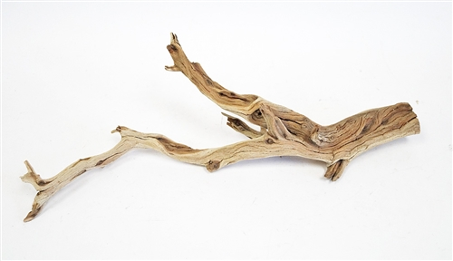
Totem Pole Project
Barry Lemoine
Troy Barrios
Mark Abshier
Shirley Barecca
Sara Felt
Sabrina Schmidt
Lenny Unbehagen

Slide 18
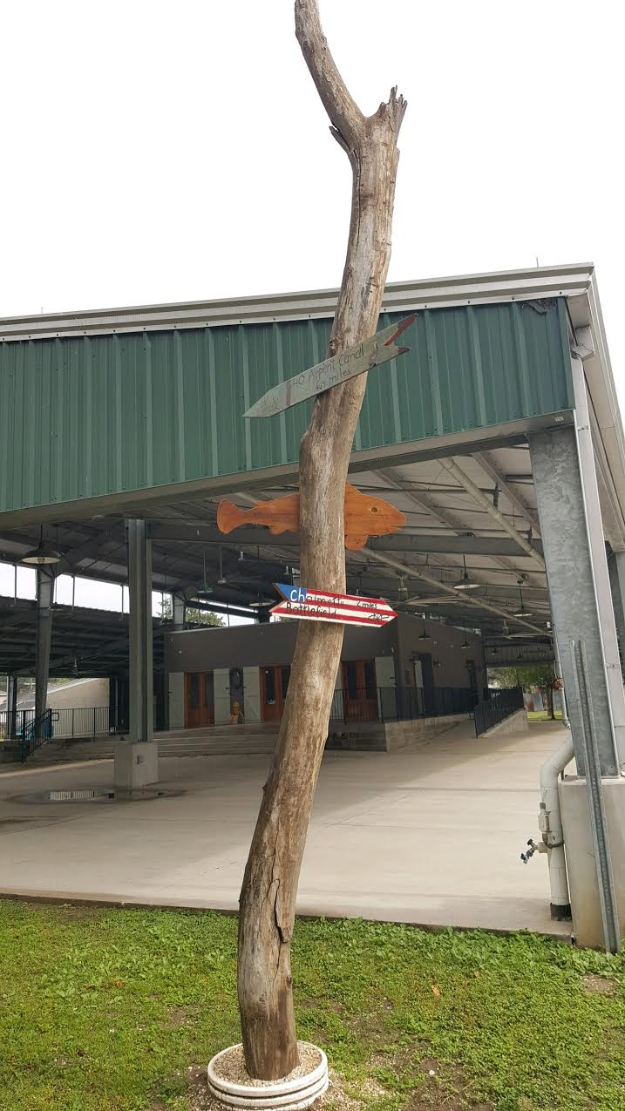
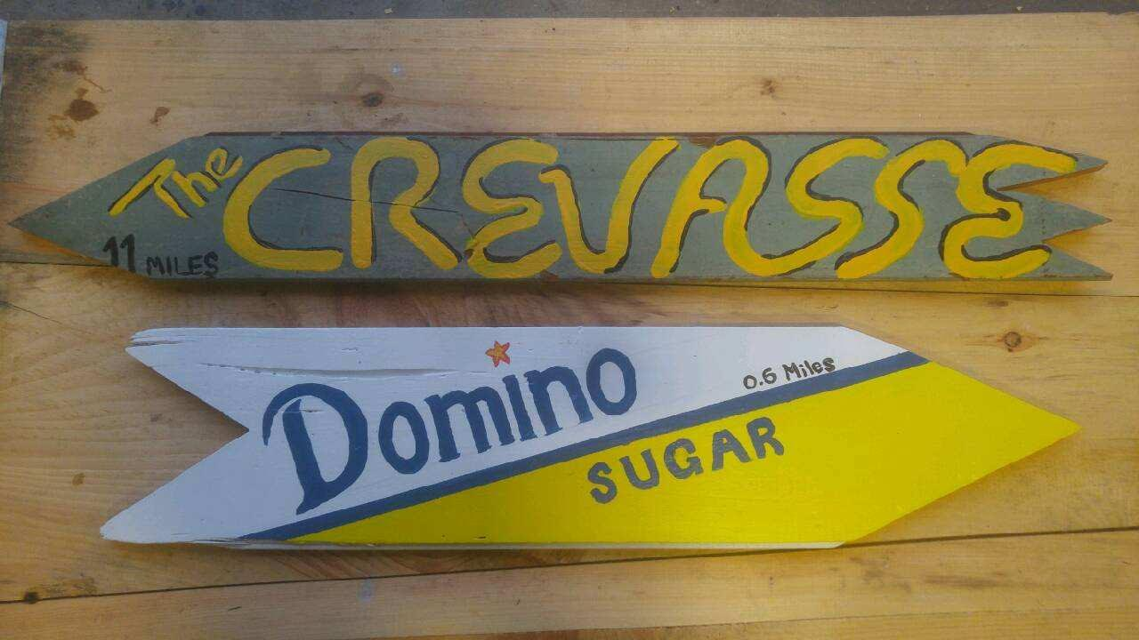
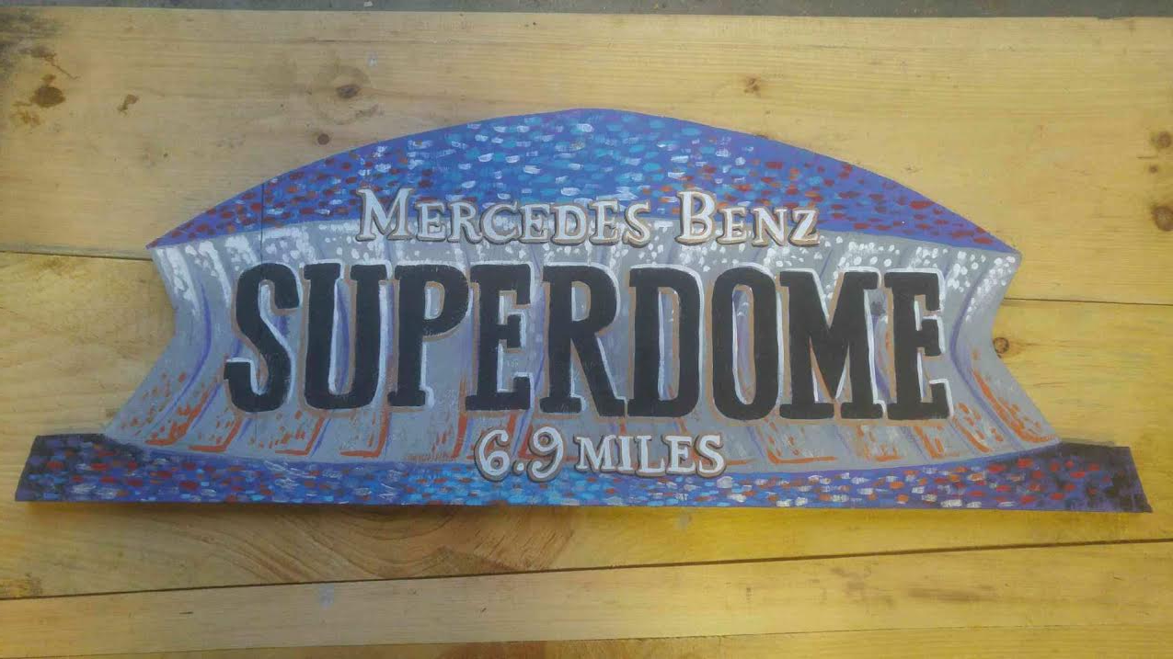
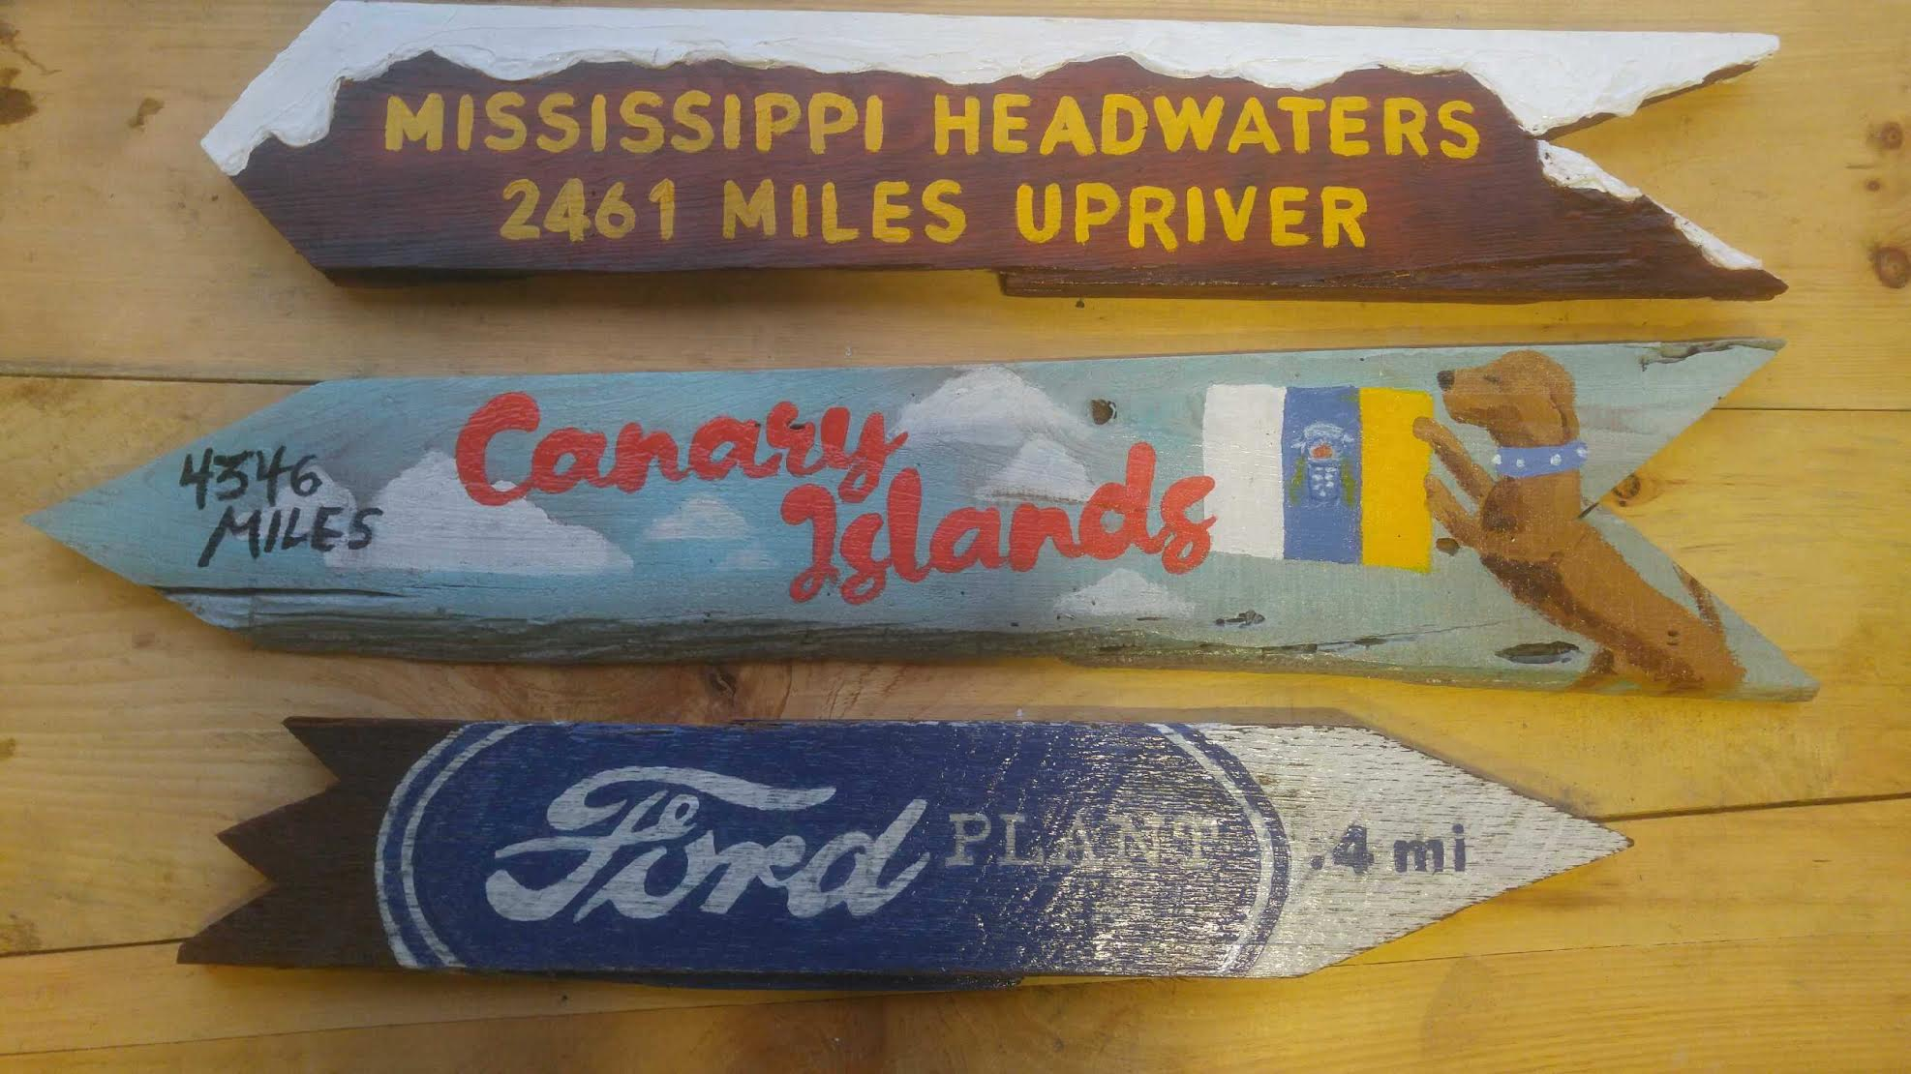
Totem Pole Project

Slide 19

Veterans Day Parade
Sunday, November 11th 9:30am
Parade will start at on Old Hickory and end at Frederick Sigur Center
Light refreshments will be available for the Veterans
To be apart of the parade or for more information please call (504) 278-1506

Slide 20


2nd Annual Veterans Appreciation Fundraiser
Friday, November 9
5:00-9:00 PM
Old Arabi Bar

Slide 21

Planetarium Dates
December 14th 6:30 PM
December 15th 11:00 AM December 15th 12:30 PM
December 19th 6:30 PM
For more information visit www.sbpsb.org or call 504-301-0239

Slide 22
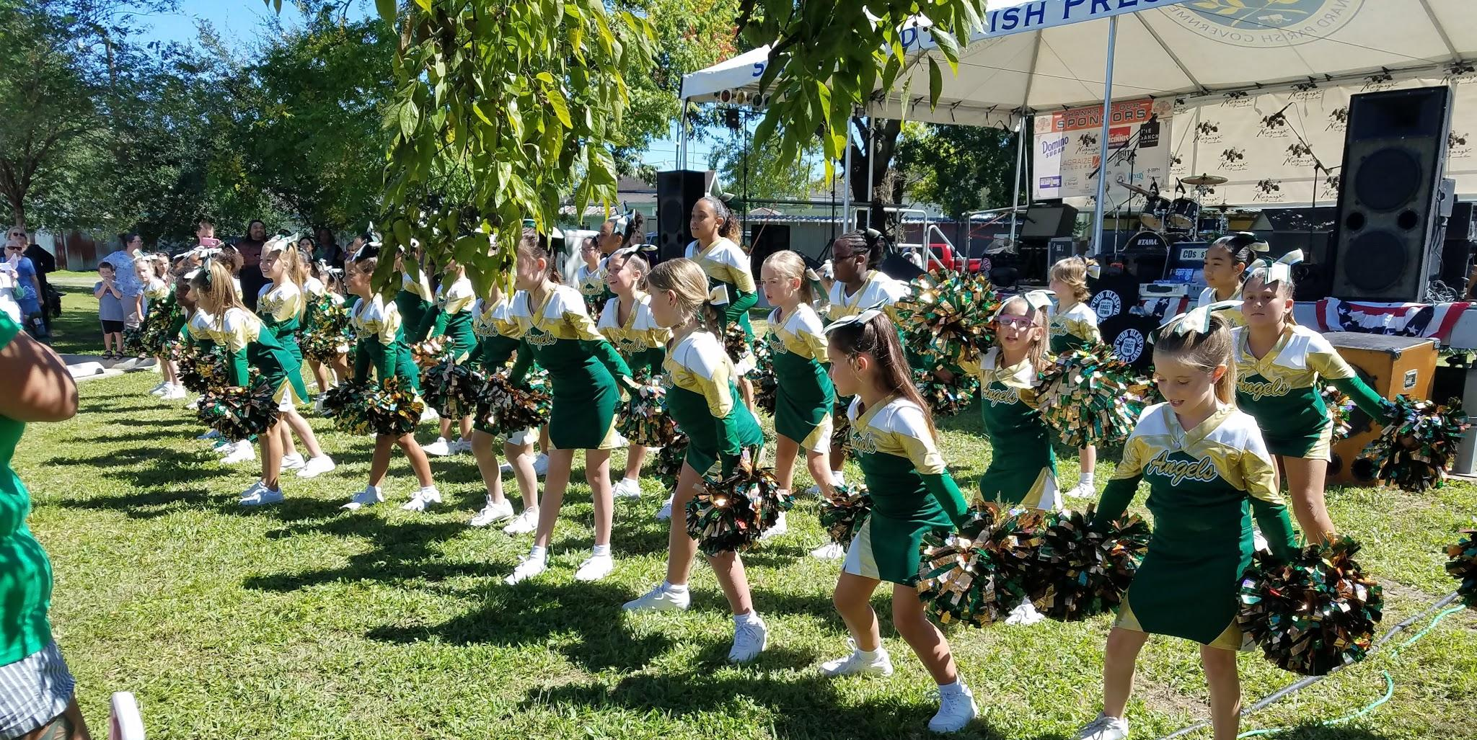
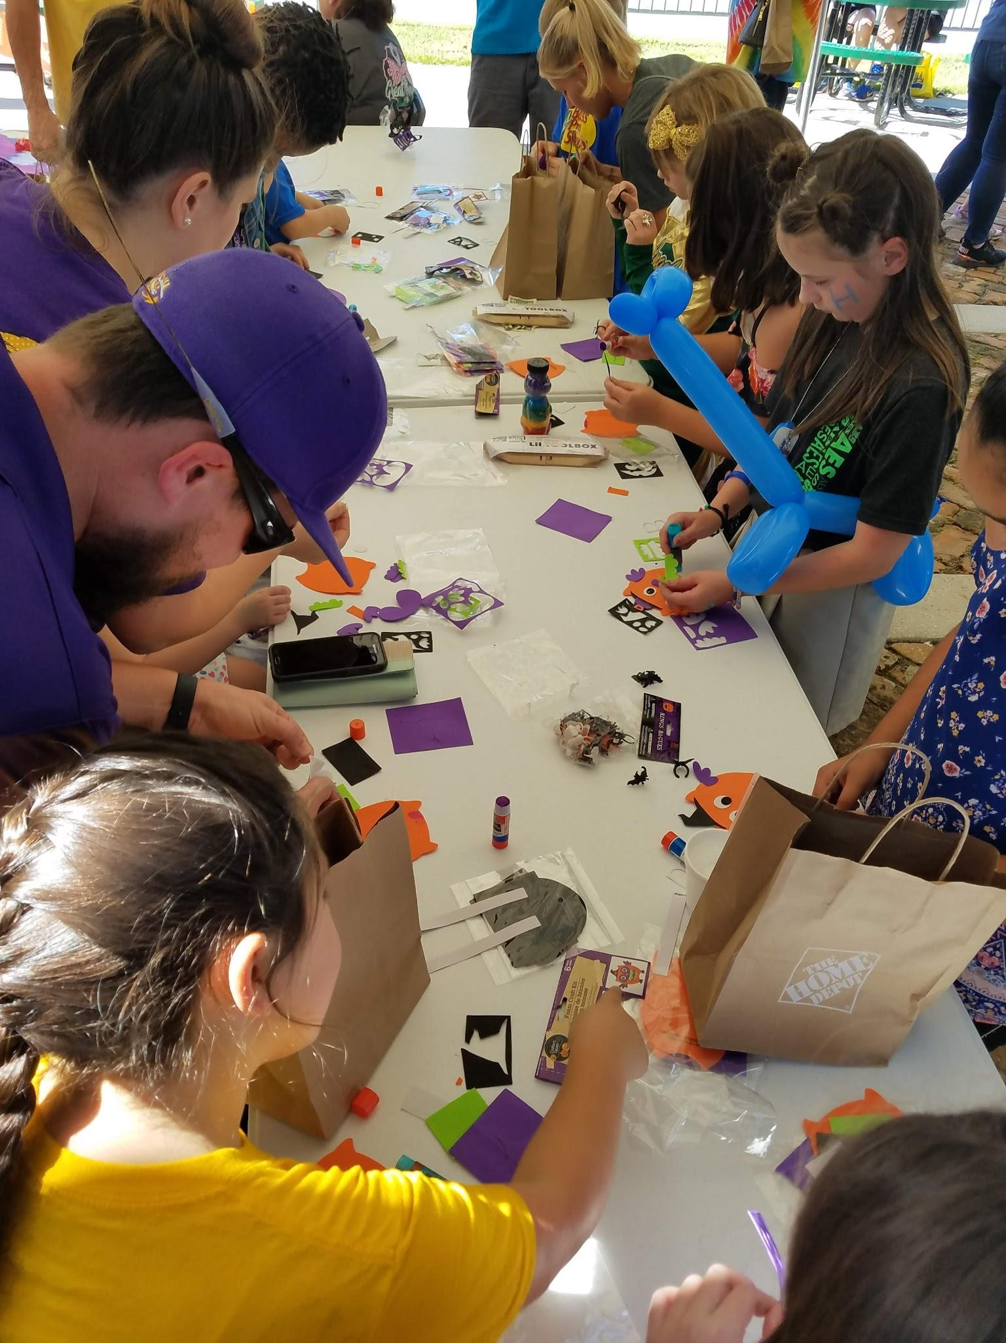
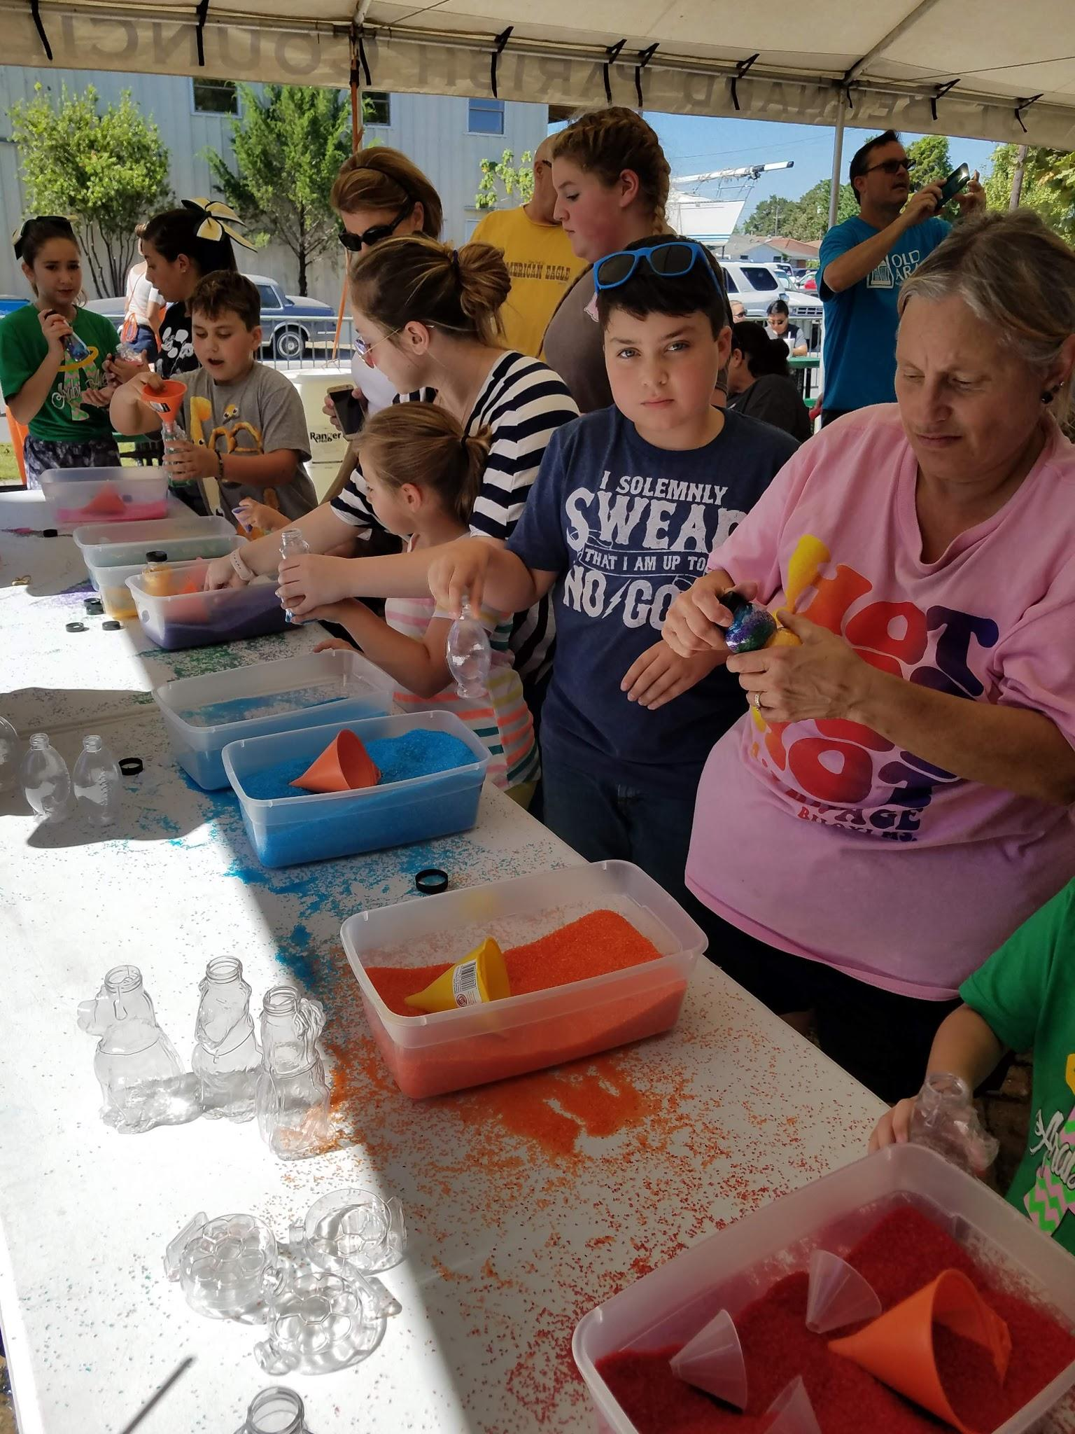
Giving Back to Community
Needy families from Arabi Elementary &
The CHS Key Club
will be the recipients of our annual giving efforts next month.

Slide 23
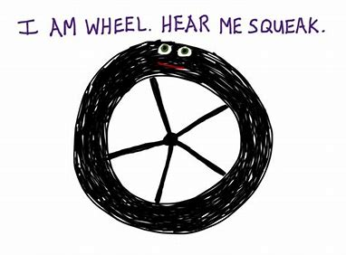
Short Term Rental Concerns
Call: Jeff McClain 278.4200
Email: dmcclain@sbpg.net
For complaints and compliance issues,
remember to
document the date and the address
for each call or concern.

Slide 24

Holiday Party
OANA Holiday Party
Kitchen Table
Cafe
12- 12
6:00-8:00 PM
Cash Bar

Slide 25
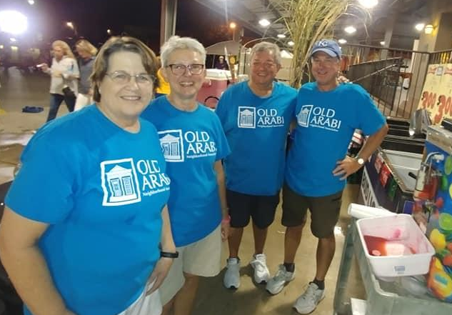
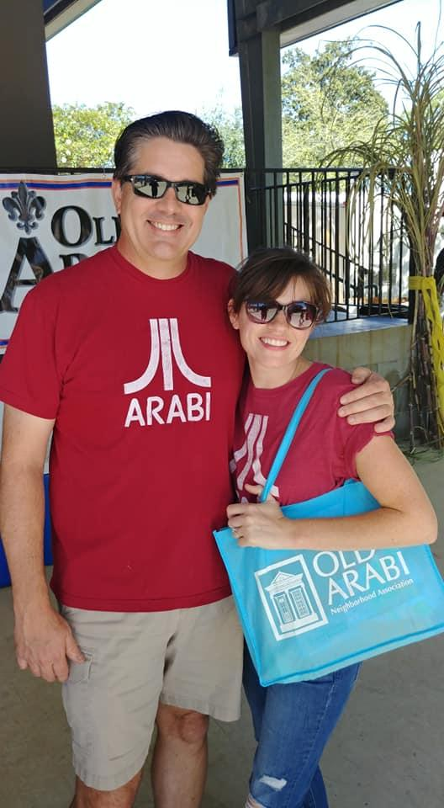
I’m not saying it’s because our
Sugar Fest was so popular but…..

Slide 26
….this was on Jeopardy recently….just saying

Slide 27
DOOR PRIZE & THAT’S ALL FOLKS
Thank you for being here tonight and for your involvement in OANA.
Thanks Gena for hosting us.
Veterans Fundraiser November 9th
Sippin in the Sunset November 15th
Shop Small Saturday November 24th
OANA Christmas Party December 12th

